Slide 1
2011 Conaway conference
Value Engineering Change Proposal

Slide 2
Goals of Value Engineering
Reduce construction costs
offer a time savings in construction without altering the essential functions and characteristics of the project
Encourage the use of the ingenuity and expertise of the Contractor

Slide 3
ODOT’s New Approach
look to the future by:
Being consistent
Ensuring all VECP’s submitted get due consideration
Timely review, final disposition, implementation, and documentation of VECPs:
tracks all VECPs
Monitor, analyze and disseminate the results of all the VECPs implemented.

Slide 4
Proposed Ways to accomplish this change
Review of CM&S 105.19:
Revisit consideration criteria listed
Update list to allow for more VECP’s
Revisit Policy and Procedure to allow more opportunities to submit for Time and/or Money
Revisit the submission process to get all stake holders involved

Slide 5
ODOT Reviewing w/FHWA
The Department will consider looking into time based VECP’s which will be discussed further with FHWA and the ODOT Committee
Contractors will have the option to request and appeal for all VECP rejections

Slide 6
Proposed changes to CM&S 105.19
The Department will not approve VECPs with any of the following characteristics:
A. Consist only of non-performing items of work contained in the plans.
B. Include plan errors identified by the Contractor as part of the cost reduction.
C. The VECP designer/consultant for the Contractor is also the designer of record for ODOT.
D. Changes to any special architectural or aesthetic treatments.

Slide 7
Proposed changes to CM&S 105.19
E. Requires concrete beams to be installed with less than 17' vertical clearance over a state highway.
F. Changes the type or buildup of permanent pavement.
G. Compromises controlling design criteria or would require a design exception as discussed in Volume I, Section 100, of the Location and Design Manual.
H. Have Contractor review the utility note and coordinate with the utility coordinator (District and Central Office) to lessen the impact on the utility.
If the utility has to incur additional costs in order to meet the contractor's VECP request, the contractor must, and is solely responsible for, reimbursing the utility for those costs.

Slide 8
Characteristics removed from 2010 C&MS 105.19
D. Changes the special architectural aesthetic treatment of structures.
E. Changes the design or thickness of cast-in-place concrete decks.
F. Changes the cross section of geometric design features such as, but not limited to, bridge width, vertical clearance, horizontal clearance, shoulder width.
H. Changes the design of overhead sign supports and breakaway sign supports.
I. Change the type of noise barriers.
J. Changes prescribed sequence of operations for the work as originally contemplated and/or the method for maintaining traffic.
N. Causes additional work, increases the cost, or causes modifications to adjacent projects.

Slide 9
Proposed Submission Process
All VECP’s must be submitted to the District
District will forward all VECP’s to the Central Office VECP Coordinator (electronic copy is acceptable)
If VECP value is under $50,000, District will accept/deny the proposal and notify the VECP Coordinator
If VECP value is over $50,000, District must include the VECP coordinator in Central Office in the decision.
The VECP coordinator will send the VECP to the Deputy Director of Construction, Planning and Engineering.
After review:
if CO and District agree with the proposed VECP, permission to proceed will be sent to the Contractor.
If VECP is denied, the Contractor will be given the opportunity to appeal.
A meeting can be requested by either party at any time.

Slide 10
Annual VECP Accomplishment Report for Federal Fiscal Year 2010
Project Number | CRS | District | Prime Contractor | Description of VE Change | Estimated Savings | Final Disposition | Final CO amount
10-1000 | DEF SR-66 007.37 | 1 | Mosser | Lime stabilization to Geotextile | $ 105,112 | Denied
09-8015 | LUC-24 | 2 | Mosser | Lower profile grade | $1,072,987.31 | Approved | $536,494
09-8015 | LUC-24 | 2 | Mosser | Grade separation | $1,323,395.24 | Approved | $661,698
10-1040 | LUC-24 | 2 | E S Wagner | Wheeling St | $77,361.30 | Approved | $38,681
09-0243 | STA-243 | 4 | Beaver Excavating |  | $10,116.00 | Approved | $5,058
09 1058 | POR LR-0 000000 | 4 | Beaver Excavating | 26" Steel case+15" PVC water pipe to 16" DIP on steel frame | $ 73,735 | Approved | $ 36,868
07-0138 | LIC SR-161 006.65 | 5 | Kokosing |  | $ 25,831 | Approved | $12,915.63
09-0513 | FRA-LR-0.00 | 6 | Double Z | Modular block wall in place of plan MSE wall | $ 58,368 | Approved | $29,183.84
09-0513 | FRA-LR-0.00 | 6 | Double Z | Oak handrail and rub rail to galvanized steel w/power coated versus wet paint | $ 26,851 | Approved | $13,425.68
09-0496 | MOT-75-11.01 | 7 | Ruhlin Company | Manhole revision | $ 77,810 | Approved | $38,905
09 0498 | BRO-52-16.16 | 9 | Sunesis Construction | Drilled shaft changes | $ 42,060 | Approved | $21,030
09 1108 | ATH/HOC-33-16.52/0.00 | 10 | Kokosing | Prestressed Pipe to Heavy wall pipe - resubmittal | $ 194,492 | Approved | $97,246
09 1080 | ATH/HOC-33-19.89/1.2 | 10 | Beaver Excavating | Mine Grouting using Deep dynamic compaction | $ 3,122,234 | Denied
09 1080 | ATH/HOC-33-19.89/1.2 | 10 | Beaver Excavating | Prestressed Pipe to Heavy wall pipe - resubmittal | $ 75,507 | Approved | $37,754
09 1080 | ATH/HOC-33-19.89/1.2 | 10 | Beaver Excavating | Prestressed pipe to Fusion welded HDPE | $ 298,693
09 1108 | ATH/HOC-33-16.52/0.00 | 10 | Kokosing | Profile grade adjustment for earthwork balance | $ 654,764 | Denied
09 1108 | ATH/HOC-33-16.52/0.00 | 10 | Kokosing | Revised piling from 33ksi to 50 ksi | $ 286,893
09 1108 | ATH/HOC-33-16.52/0.00 | 10 | Kokosing | Mine grouting using deep cut and fill | $ 769,257 |  | $ 384,628.42
09 1080 | ATH/HOC-33-19.89/1.2 | 10 | Kokosing | 42" Special culvert drainage design | $ 75,498 |  | $ 37,749.24
09 1108 | ATH/HOC-33-16.52/0.00 | 10 | Kokosing | Modify Structures HOC-33-1697,1829,1908, and 1986 | $ 403,448 |  | $ 201,724.25
 |  |  |  |  |  | Sum of VECP's | $2,153,359

Slide 11
VECP program goals and measures Overview
To ensure consistency among the Districts it is recommended that all VECP’s should be sent to Central Office for review before any decision on accepting or denying a VECP is made.
Authorization for rejection of a VECP will be housed at a higher level within the organization than the authorization for approval.
To foster as many innovative proposals as possible specifications are being reviewed to remove restrictions and provide further flexibility as to what VECP’s will be considered.

Slide 12
Estimating’s Role
Establish GUARANTEED MINIMUM SAVINGS
Notes:
Check the costs against the bids.
Establish if new costs are reasonable.
To assist in assuring the Standard Procedure for Value Engineering In Construction Policy is followed as it pertains to costs and savings.

Slide 13
Standard Procedure
Standard Procedure for Value Engineering In Construction, Policy No. 510-008(SP), effective 2/1/2010
The SOP states: The purpose of this provision is to encourage the use of ingenuity and expertise of the Contractor …….....
Notes:
Underlined use of ingenuity and expertise of the Contractor to emphasize that the VECP’s are not simply pay for items that are being non-performed or taking what Departmental changes have been asked for.

Slide 14
Preliminary Submittal
The Contractor will submit the following as part of a VECP:
Separate detailed cost estimates for both the existing contract requirements and the proposed change. The cost estimates shall be broken down by contract item numbers indicating quantity increases or decreases and deleted pay items.
Additional proposed work, not covered by contract items, shall be identified by current Department pay item numbers. In preparing the estimates, the contractor shall include overhead and profit. No separate pay items are allowed for these costs.
Notes:
To Summarize - VECP shall include:
Item number – original contract qty - original contract bid price – new qty
All new items of work shall include a Department Pay Item Number and description.

Slide 15
Items of Concern
PARTIAL Lump sum items
VECP’s that state “will secure actual quantities as design or construction occur”.
Items that appear to be removed as non-performed but put back in as ‘New Work’ with different cost.
VECP items that in original bid appear to have been bid with VECP in mind.
Notes:
Lump Sum – hard to estimate has changed, what's already been done and a fair price.
Changing Qty’s – we set a GUARANTEED MINIMUM SAVINGS. Accepting these sets us up to lose that!
If the same or similar work as original bid is being performed it must be performed at the original bid price.
The Bidding Process can be harmed at a date later than the bid opening… meaning we have found VECP’s that were bid and they affect items that obviously have been manipulated in the bidding process with the VECP in mind.

Slide 16
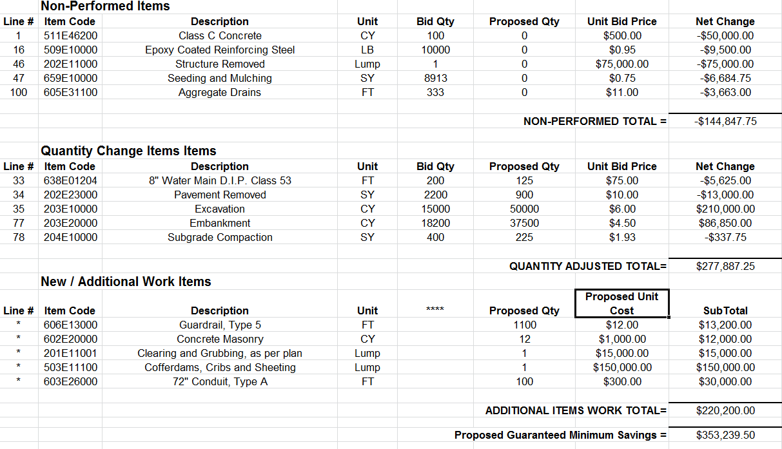
VECP sample # 1
Notes:
This is a template in Excel of proper way to summarize and submit costs for VECP. We can provide this template to anyone that would like a copy.

Slide 17
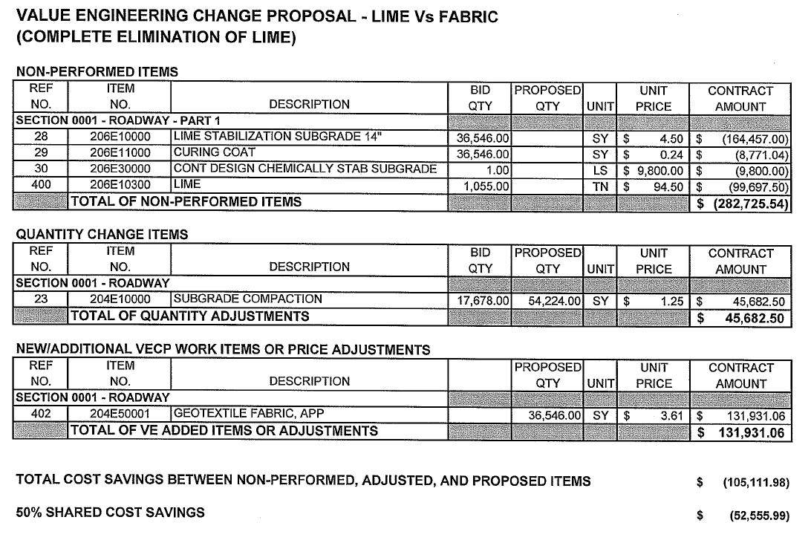
VECP sample # 2
Notes:
Good use of format. Easy to follow.
Large qty changes for an entire operation will get some extra scrutiny but looks good on surface.

Slide 18
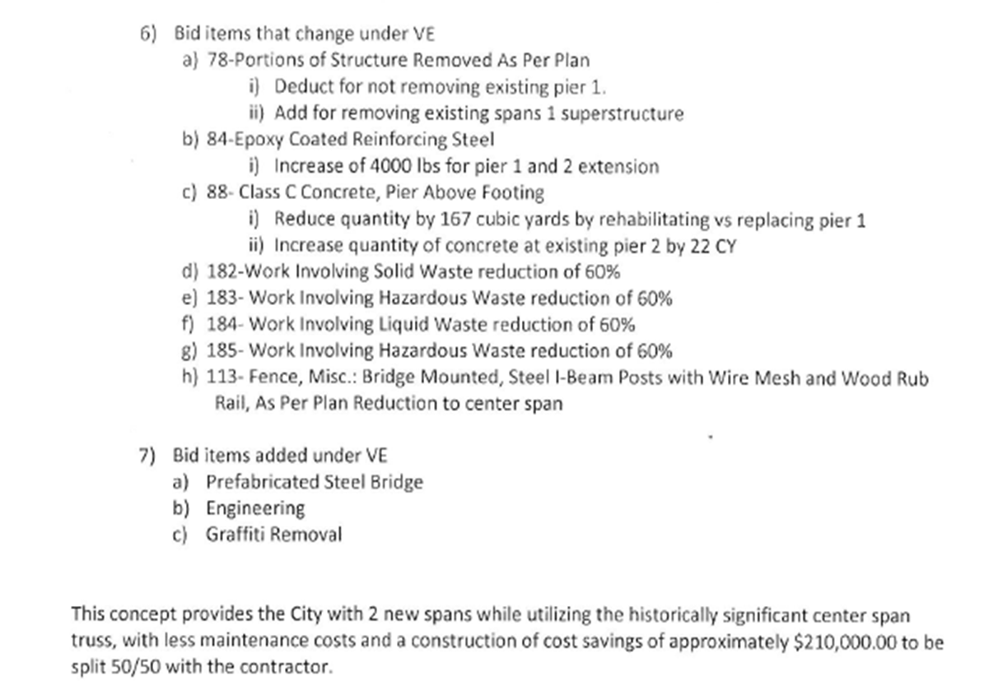
VECP sample # 3
Notes:
No references.
No original bids.
No item numbers.
No qty changes.
No Plans.
Lump sum total??? How do we estimate this? SEE NEXT SLIDE.

Slide 19
Notes:
Obviously time can be saved if we submit properly the first time.

Slide 20
ODOT Project 467(06) SR 8/I-271 Reconstruction City of Macedonia VECP Proposal

Slide 21
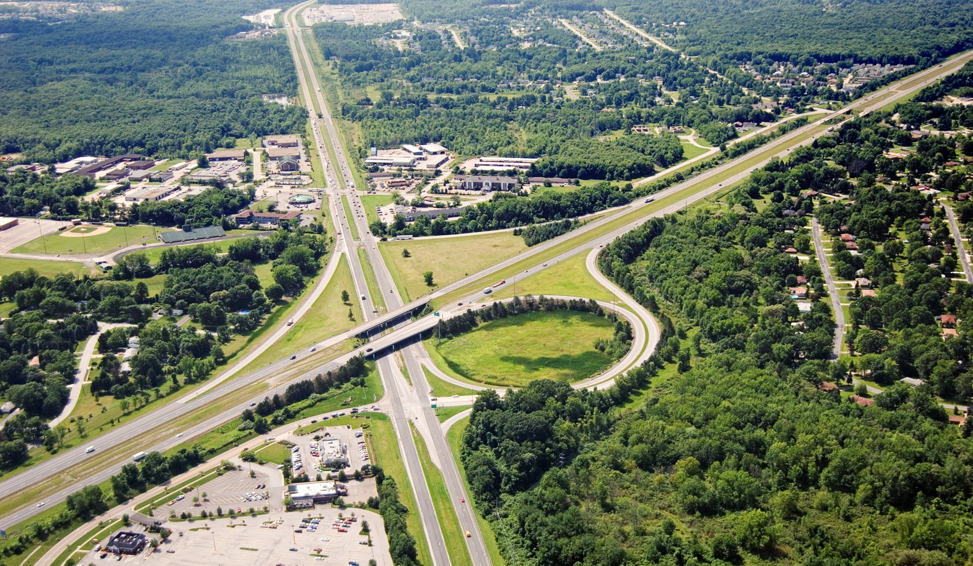
July 2006

Slide 22
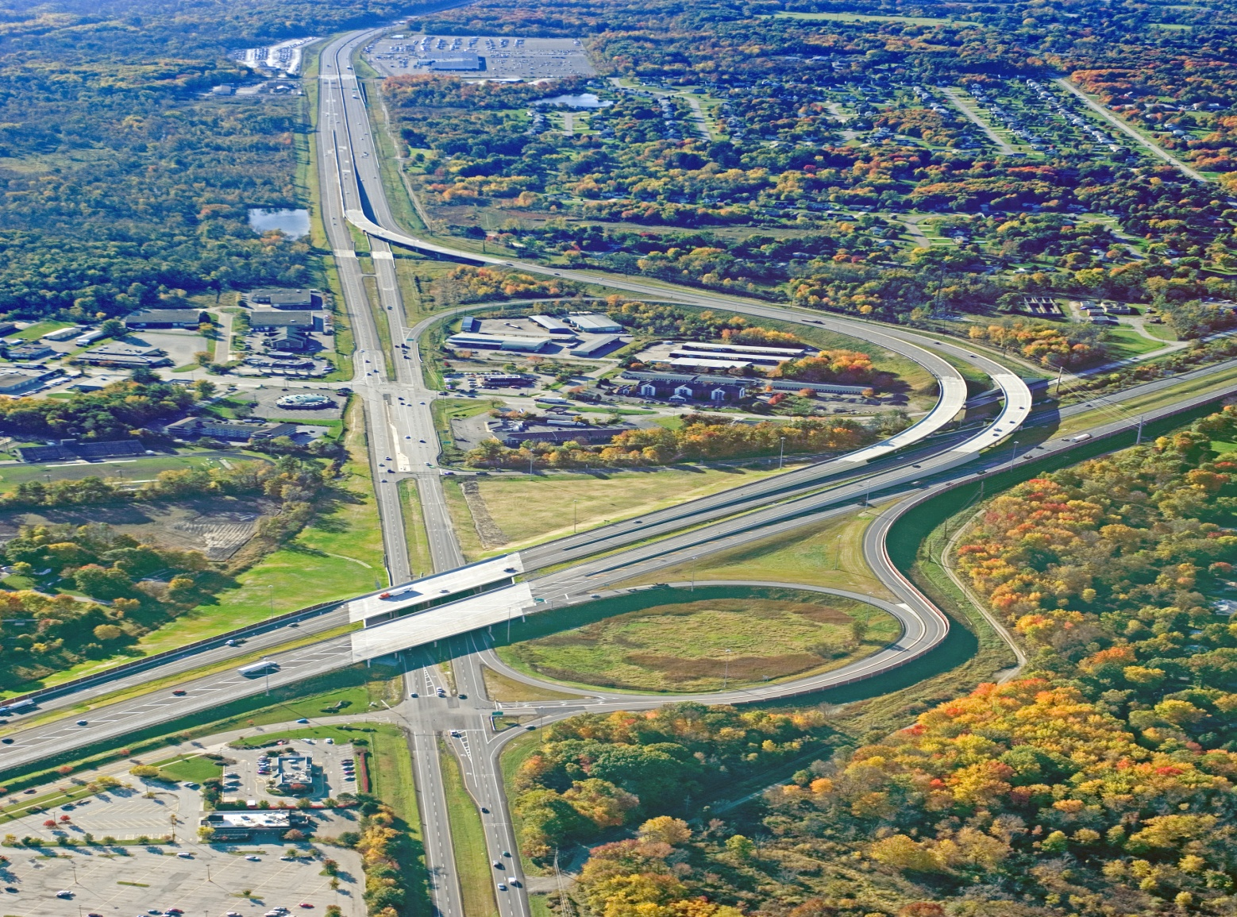
October 2009
New on-ramp
Old ramp eliminated

Slide 23
Typical Geologic Cross-Section
Multiple glacial advances/retreats filled valley with soft/loose and compressible glaciofluvial and glaciolacustrine sediments (A-4 to A-6 soils); Flat, poorly draining topography, and adjacent streams left soft, organic deposits near the ground surface; High static groundwater table – within 10 ft of ground surface over project.

Slide 24
Engineering Properties of Soils
Key Observations: Glaciolacustrine soils are soft/loose materials based on SPT results and visual descriptions, but all are overconsolidated. Piezocone testing indicates that non-plastic silts (A-4a and A-4b) dissipate pore pressures 2-3 orders of magnitude faster than soils with higher plasticity and clay content.

Slide 26
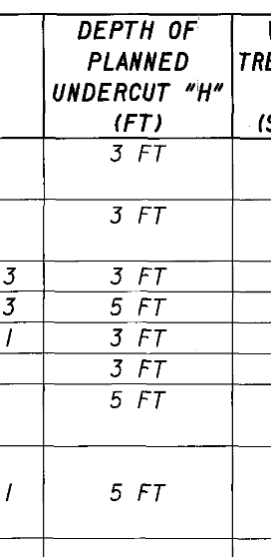

Slide 27
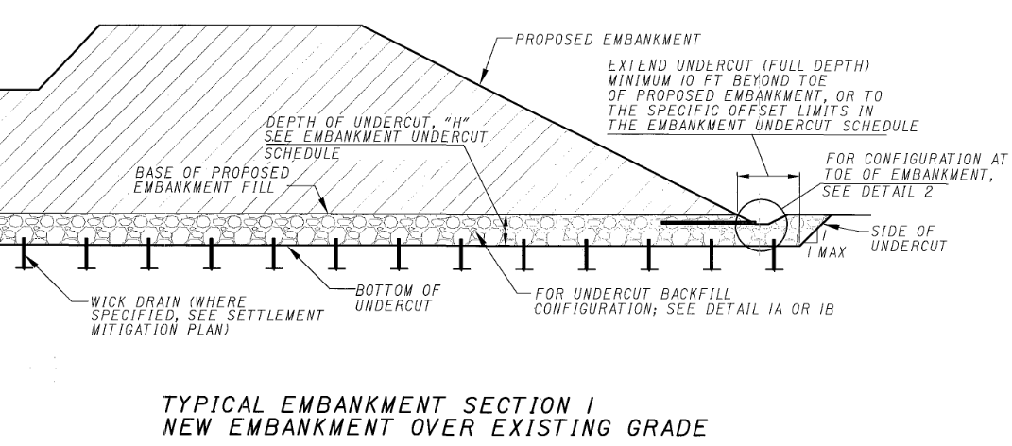

Slide 28
Typical Undercut Backfill Section
Embankment
Type D Geotextile
Original Grade
3-5 ft
Type D Granular
Undercut Depth

Slide 29
Typical Undercut Backfill Configuration
– with Wick Drains
Embankment
Type D Geotextile
Original Grade
3-5 ft
Type D Granular
18” Type E Granular
Undercut Depth
Wick drain (TYP)

Slide 30
Final VECP Proposal SUM 467(06)
Modifies the embankment subgrade improvement plan and pavement subgrade improvement plan
Replace the total thickness of granular with reduced thickness and layers of fabrics and grids.
Raises elevation of drainage layer to allow more positive drainage
7 embankment scenarios
2 pavement scenarios

Slide 31
VECP Proposal
Fabric on bottom of undercuts prevents contamination of drainage layer
Grid supplier Contech- fabric does not reduce structural properties of the grid
Wick drains outlet in higher drainage level
Improvement below MSE walls changed to sand to prevent piping into stabilized materials

Slide 32
Non-Performed Items
Item | Description | Unit | Quantity | Total
203 | Embankment | CY | 28,092 | $ (268,278.60)
204 | Excavation of Subgrade | CY | 100,689 | $ (662,533.62)
204 | Granular Material, Type D, APP | CY | 112,285 | $(2,739,754.00)
204 | Granular Material, Type E, APP | CY | 22,648 | $ (612,175.44)
$ (4,282.741.66)
Additional Items
203 | Wick Drains w/o Predrilling | FT | 19,069 | $ 9,343.81
204 | Granular Material, Type B | CY | 18,112 | $ 312,432.00
204 | Geotextile Fabric | SY | 102,596 | $ 112,855.50
304 | Aggregate Base | CY | 685 | $ 26,030.00
204 | Granular Material, Type C | CY | 9,105 | $ 309,205.80
204 | Granular Material, Type F | CY | 34,465 | $ 899,191.85
Sp | Geogrid Tensar BX-1200 | SY | 266,911 | $ 1,267,827.25
Sp | Geogrid Tensar BX-1300 | SY | 27,314 | $ 119,635.32
$ 3,056,521.63

Slide 33
Cost Savings
Non-Preformed $ 4,282,741.66
Additional Items $ 3,056,521.63
Total Savings $ 1,226,220.03
50/50 Split $ 613,110.02

Slide 34
VECP Proposal
Original Grade
Detail “A”

Slide 35
VECP Proposal
Original Grade
12” Undercut
Detail “A”

Slide 36
VECP Proposal
Original Grade
8oz Geotextile
12” Undercut
Detail “A”

Slide 37
VECP Proposal
Original Grade
BX-1200 Geogrid
8oz Geotextile
12” Undercut
Detail “A”

Slide 38
VECP Proposal
Original Grade
12” Granular Type E
BX-1200 Geogrid
8oz Geotextile
12” Undercut
Detail “A”

Slide 39
VECP Proposal
BX-1200 Geogrid
Original Grade
12” Granular Type E
BX-1200 Geogrid
8oz Geotextile
12” Undercut
Detail “A”

Slide 40
12” Granular Type D
BX-1200 Geogrid
Original Grade
12” Granular Type E
BX-1200 Geogrid
8oz Geotextile
12” Undercut
Detail “A”

Slide 41
Type D Geotextile
12” Granular Type D
BX-1200 Geogrid
Original Grade
12” Granular Type E
BX-1200 Geogrid
8oz Geotextile
12” Undercut
Detail “A”

Slide 42
Type D Geotextile
12” Granular Type D
BX-1200 Geogrid
Original Grade
12” Granular Type E
BX-1200 Geogrid
8oz Geotextile
Wick drain (TYP)
12” Undercut
Detail “A”

Slide 43
Embankment
Type D Geotextile
12” Granular Type D
BX-1200 Geogrid
Original Grade
12” Granular Type E
BX-1200 Geogrid
8oz Geotextile
Wick drain (TYP)
12” Undercut
Detail “A”

Slide 44
VECP Proposal
Original Grade
Detail “B”

Slide 45
VECP Proposal
Original Grade
26” Undercut
Detail “B”

Slide 46
VECP Proposal
Original Grade
8oz Geotextile
26” Undercut
Detail “B”

Slide 47
VECP Proposal
Original Grade
BX-1200 Geogrid
8oz Geotextile
26” Undercut
Detail “B”

Slide 48
VECP Proposal
Original Grade
13” Fine Aggregate
BX-1200 Geogrid
8oz Geotextile
26” Undercut
Detail “B”

Slide 49
Original Grade
BX-1200 Geogrid
13” Fine Aggregate
BX-1200 Geogrid
8oz Geotextile
26” Undercut
Detail “B”

Slide 50
13” Fine Aggregate
Original Grade
BX-1200 Geogrid
13” Fine Aggregate
BX-1200 Geogrid
8oz Geotextile
26” Undercut
Detail “B”

Slide 51
Type D Geotextile
13” Fine Aggregate
Original Grade
BX-1200 Geogrid
13” Fine Aggregate
BX-1200 Geogrid
8oz Geotextile
26” Undercut
Detail “B”

Slide 52
Type D Geotextile
13” Fine Aggregate
Original Grade
BX-1200 Geogrid
13” Fine Aggregate
BX-1200 Geogrid
8oz Geotextile
Wick drain (TYP)
26” Undercut
Detail “B”

Slide 53
MSE wall
Select
Granular
Embankment
Type D Geotextile
13” Fine Aggregate
Original Grade
BX-1200 Geogrid
13” Fine Aggregate
BX-1200 Geogrid
8oz Geotextile
Wick drain (TYP)
26” Undercut
Detail “B”

Slide 54
Embankment
Type D Geotextile
12” Type D Granular
13” Type E Granular
Original Grade
BX-1200 Geogrid
13” Type E Granular
BX-1200 Geogrid
8oz Geotextile
Wick drain (TYP)
26” Undercut
Detail “C”

Slide 55
MSE wall
Select
Granular
Embankment
Type D Geotextile
12” Fine Aggregate
Original Grade
BX-1200 Geogrid
12” Fine Aggregate
BX-1200 Geogrid
8oz Geotextile
Wick drain (TYP)
24” Undercut
Detail “D”

Slide 56
Embankment
Type D Geotextile
12” Granular Type D
BX-1200 Geogrid
Original Grade
12” Granular Type E
BX-1200 Geogrid
8oz Geotextile
Wick drain (TYP)
12” Undercut
Detail “E”

Slide 57
VECP Proposal
Proposed Pavement
Type D Geotextile
Original Grade
12” Type B Granular
24” Type D Granular
Type D Geotextile
36” Undercut
Detail “P-1”

Slide 58
Supplemental Specification 861
October 15, 2010
Work consisting of furnishing and installing biaxial geogrid for the purpose of stabilizing subgrade.
Place geotextile fabric on bottom if specified
Geogrid for Subgrade Stabilization

Slide 59
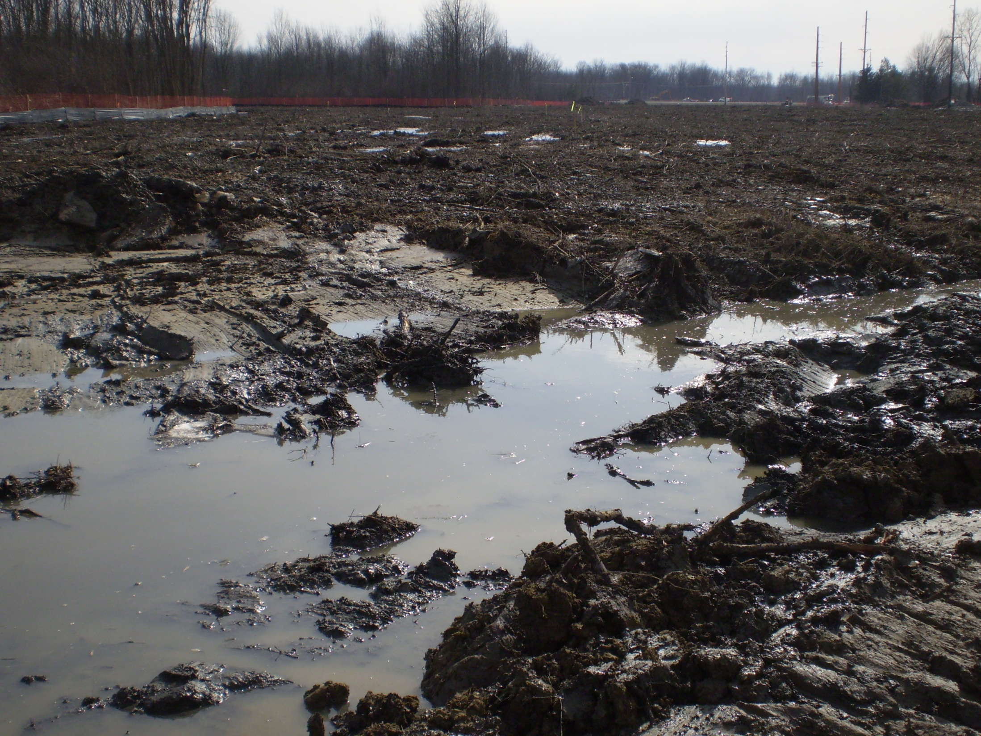

Slide 60
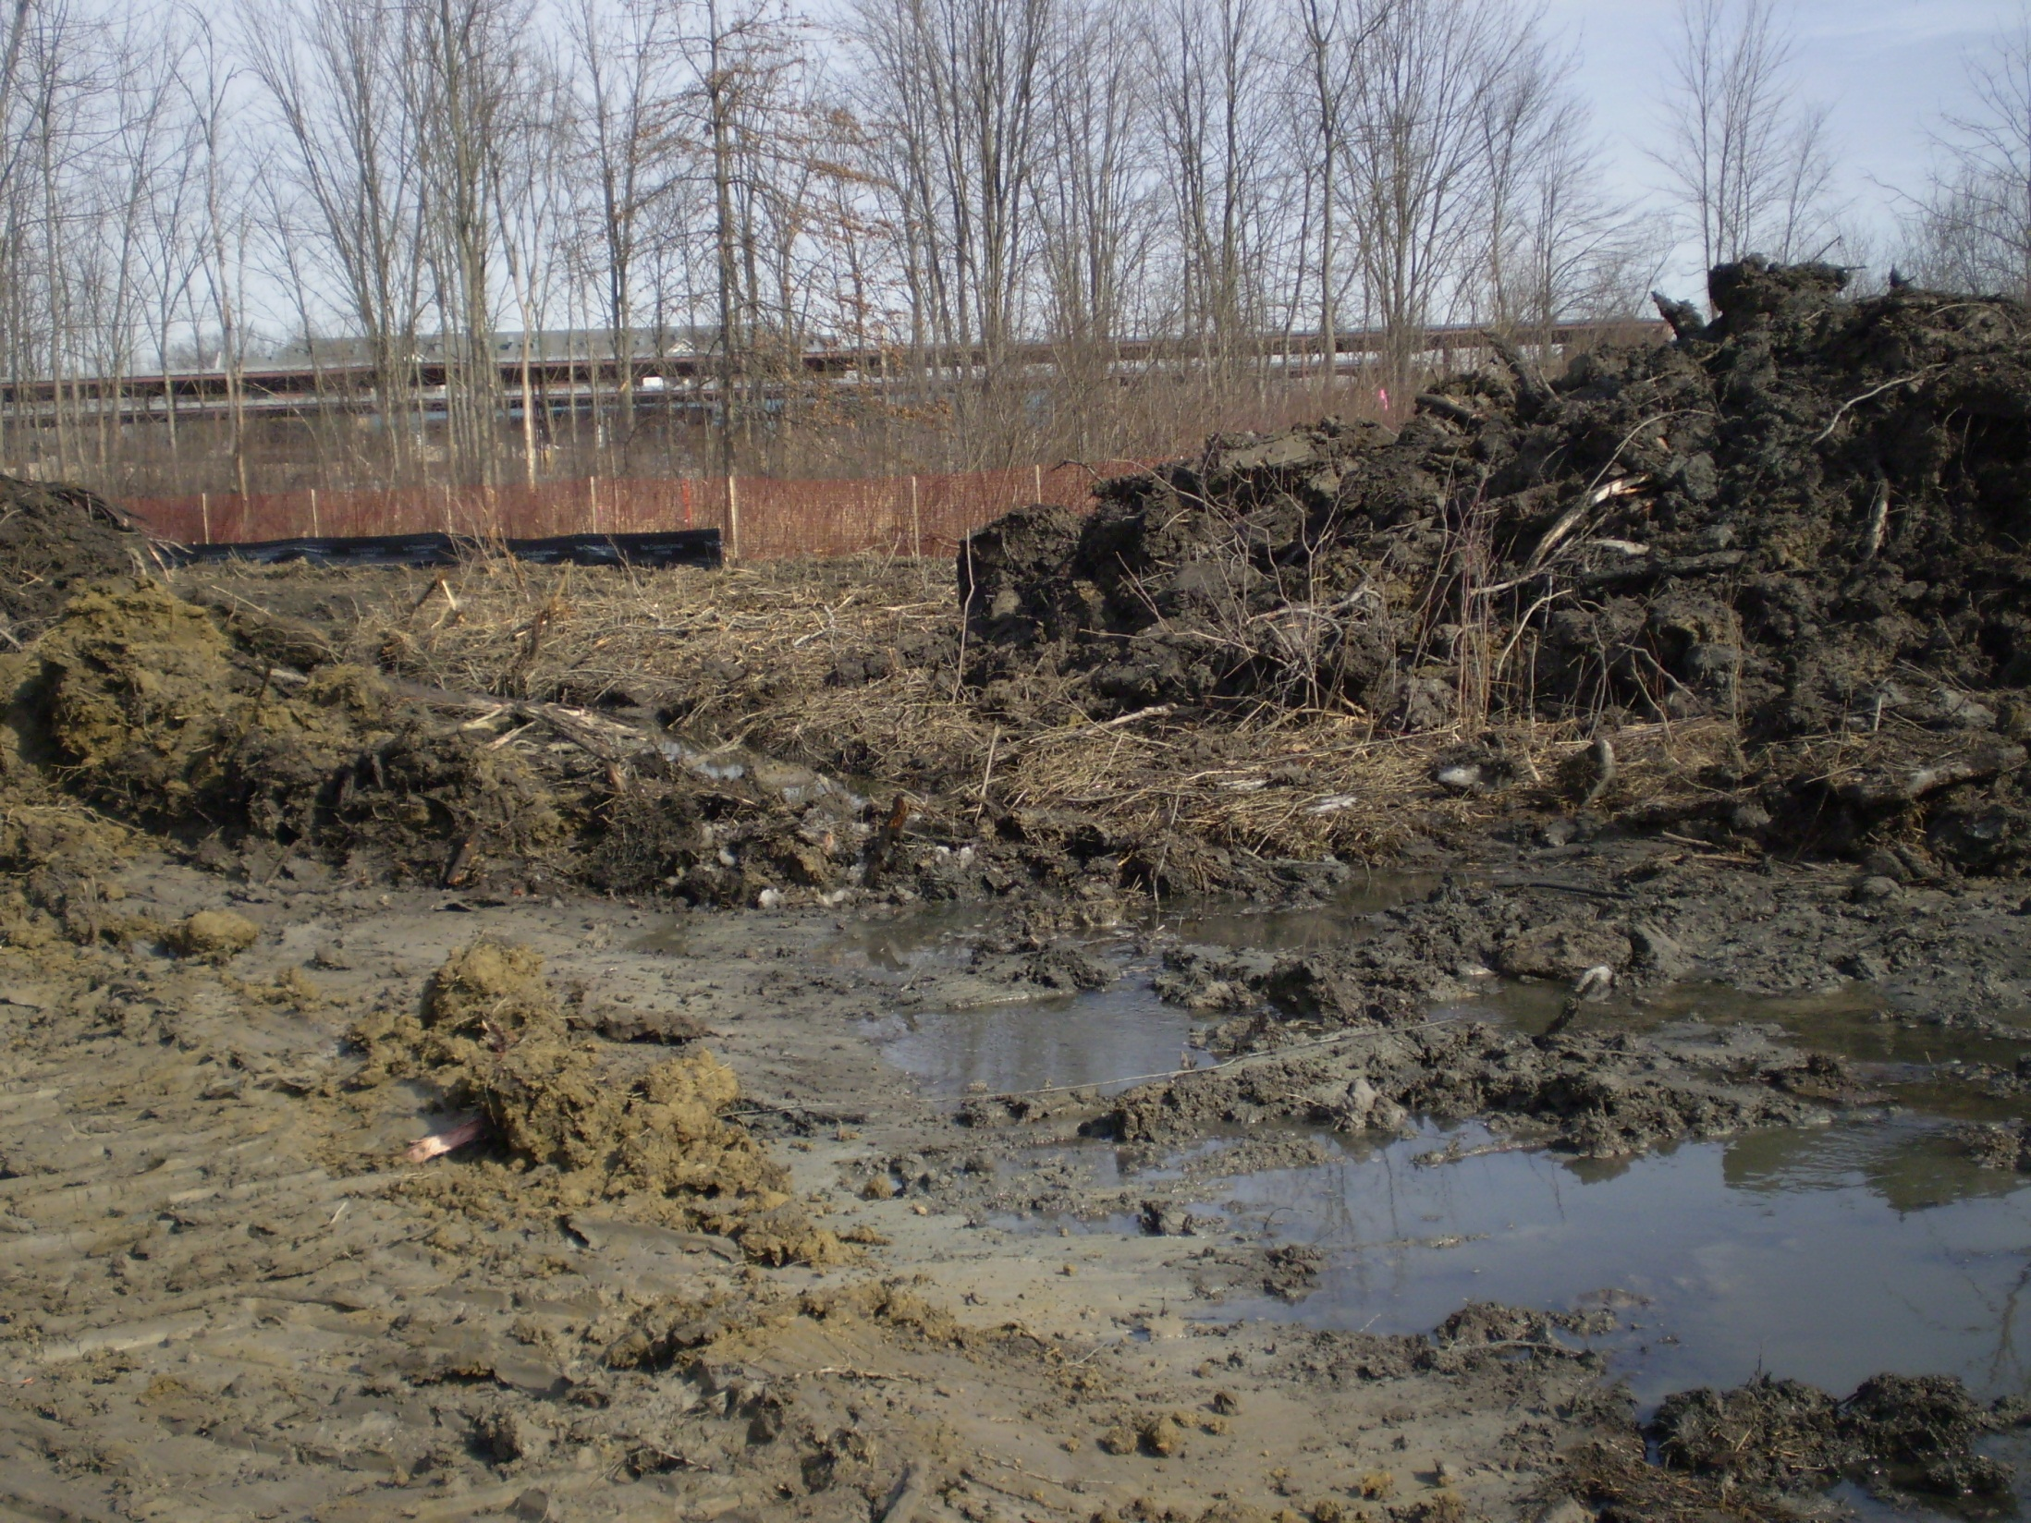

Slide 61
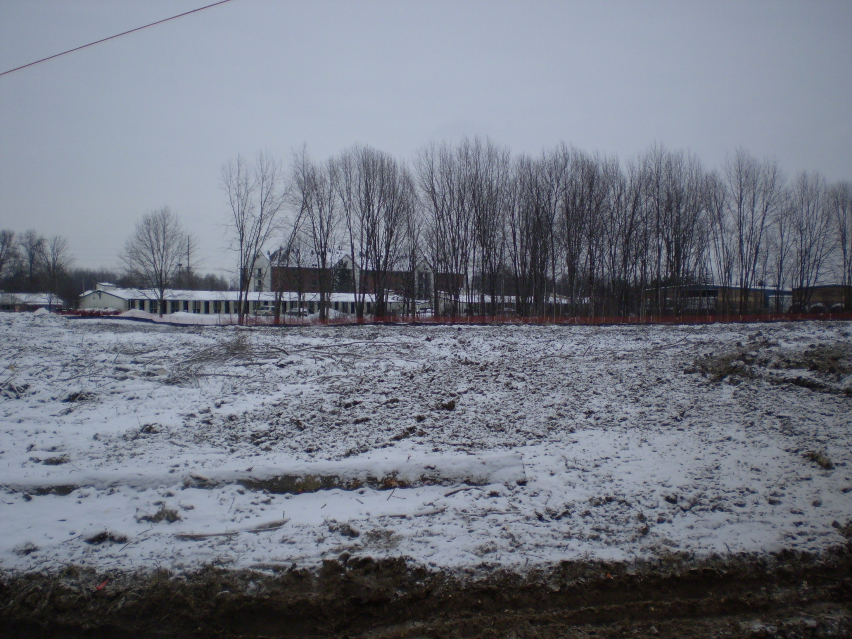

Slide 62
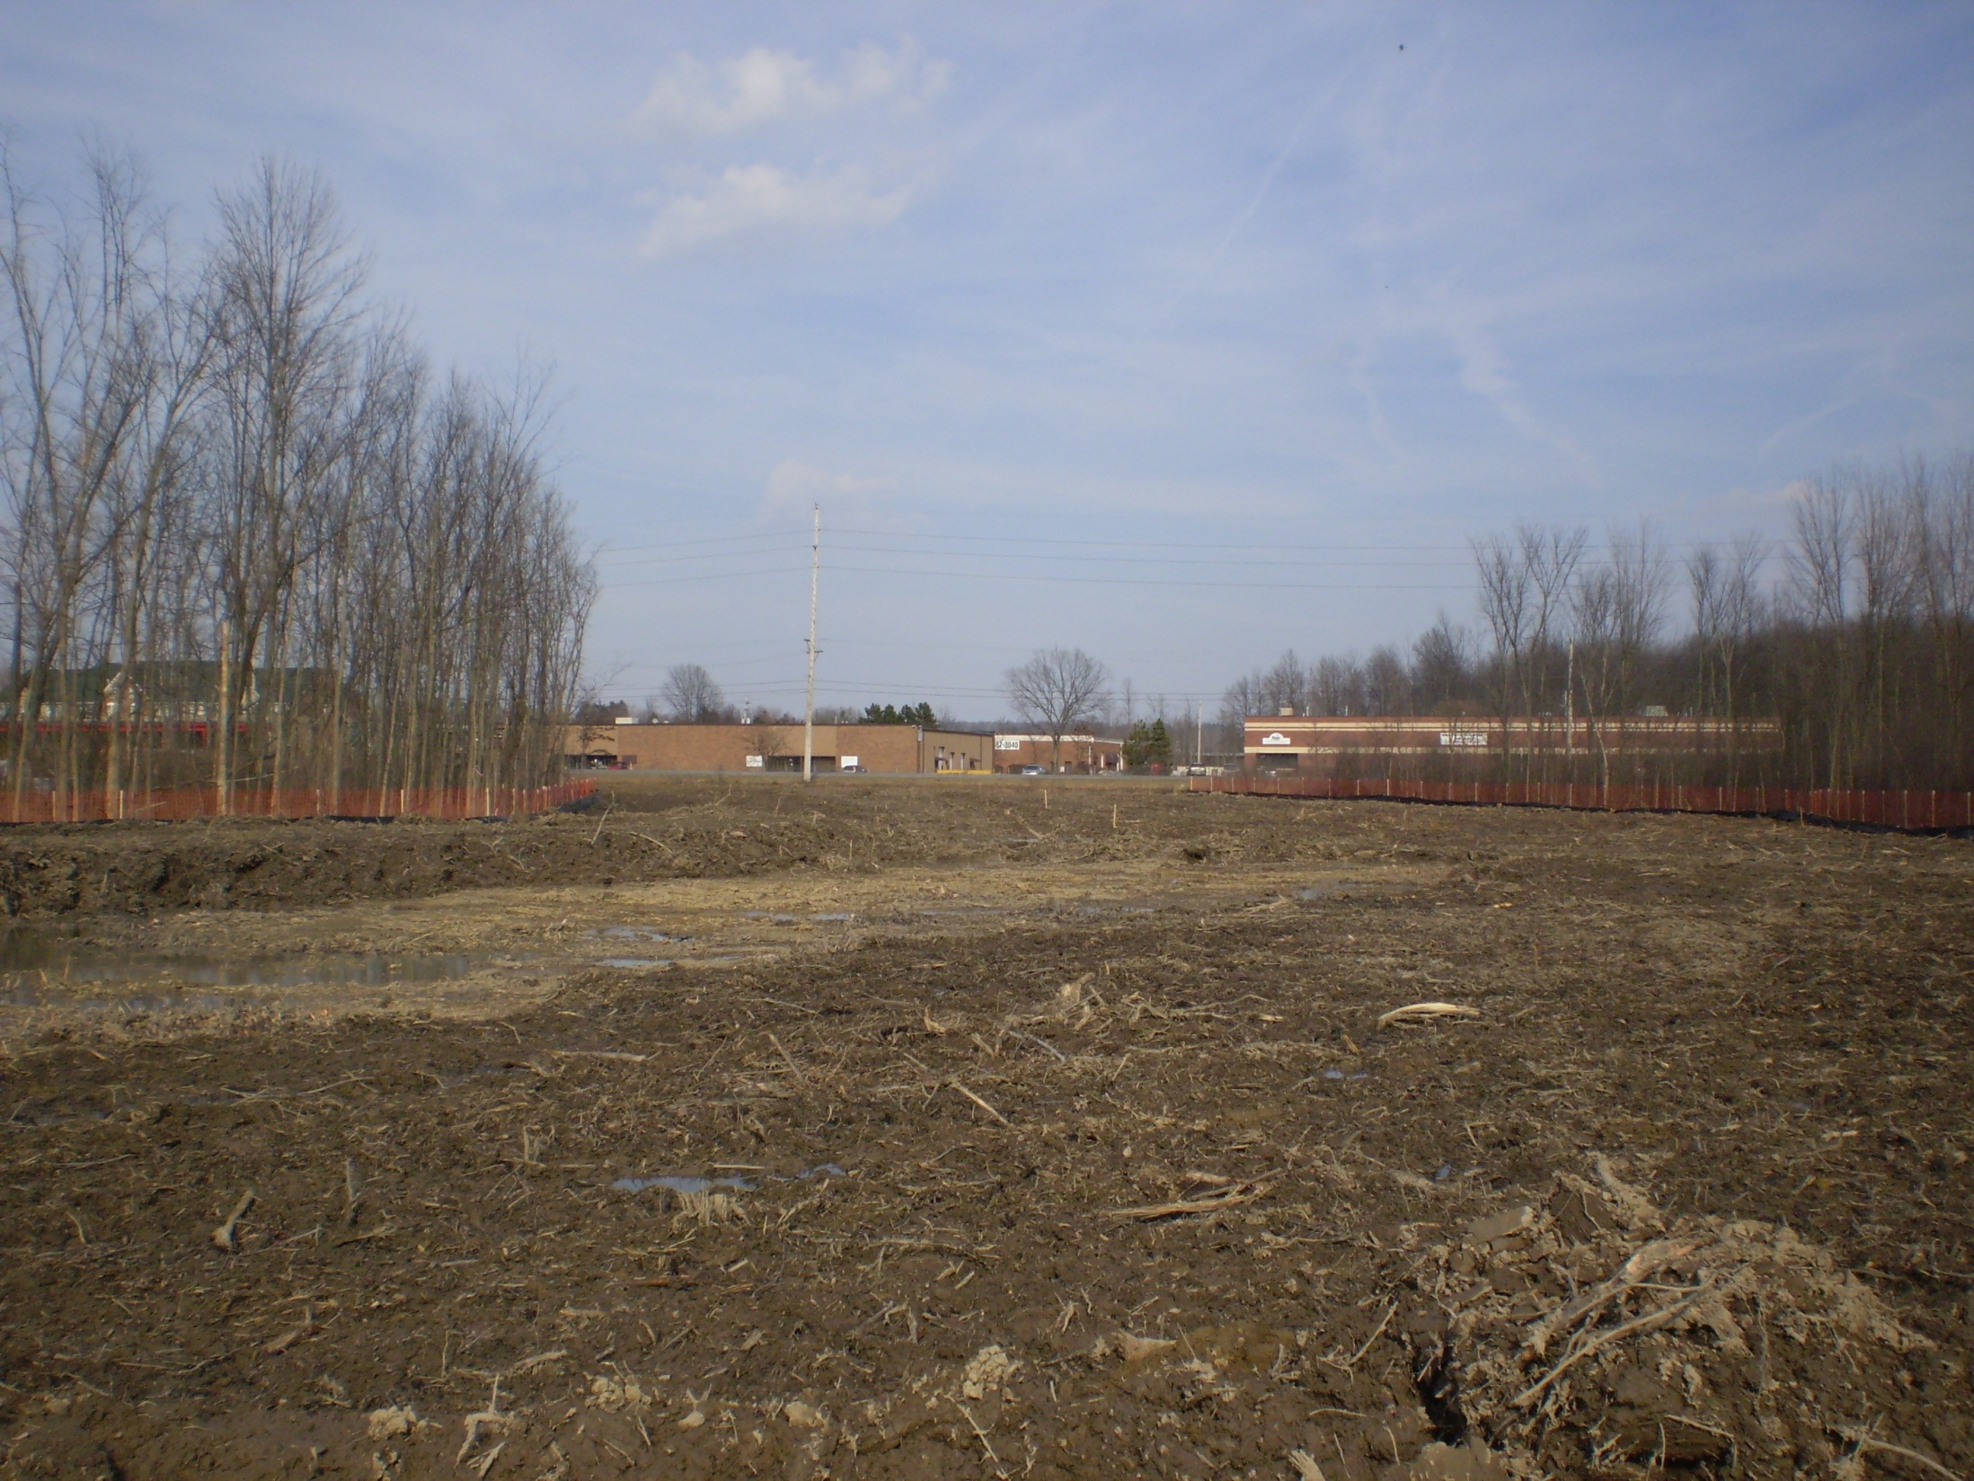

Slide 63
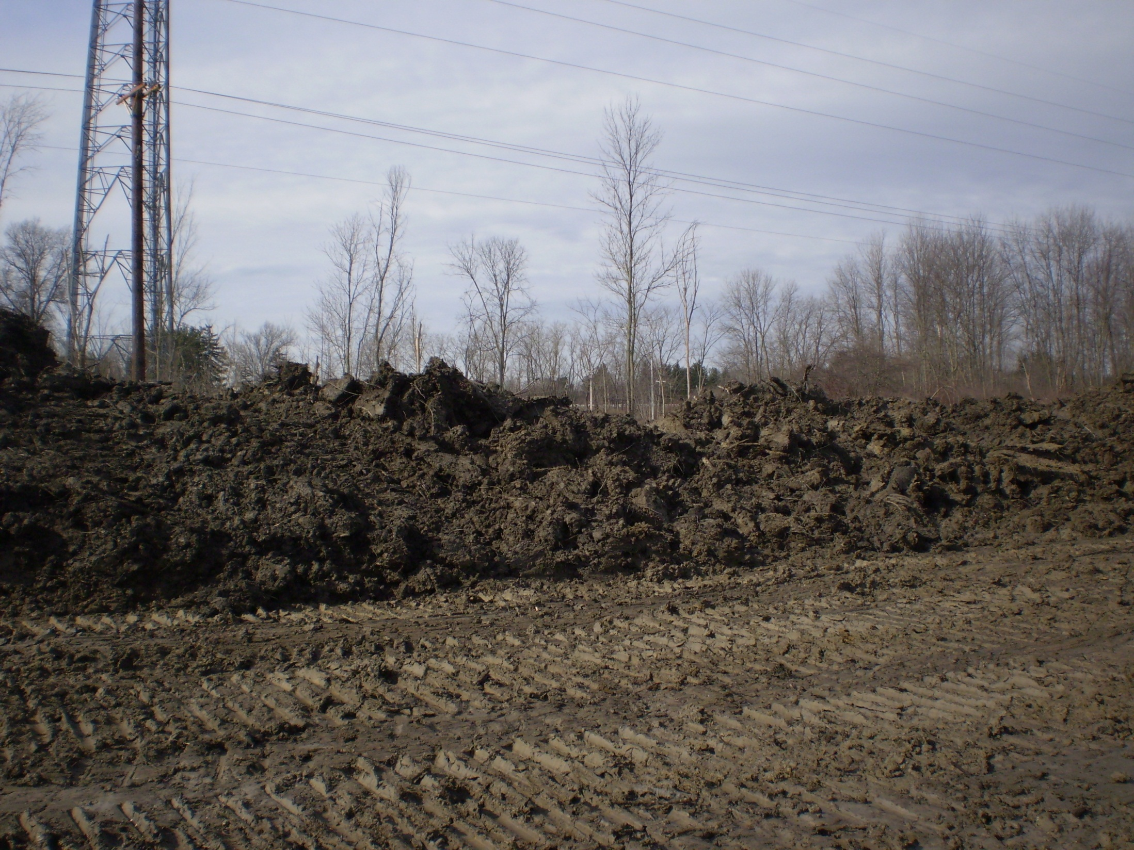

Slide 64
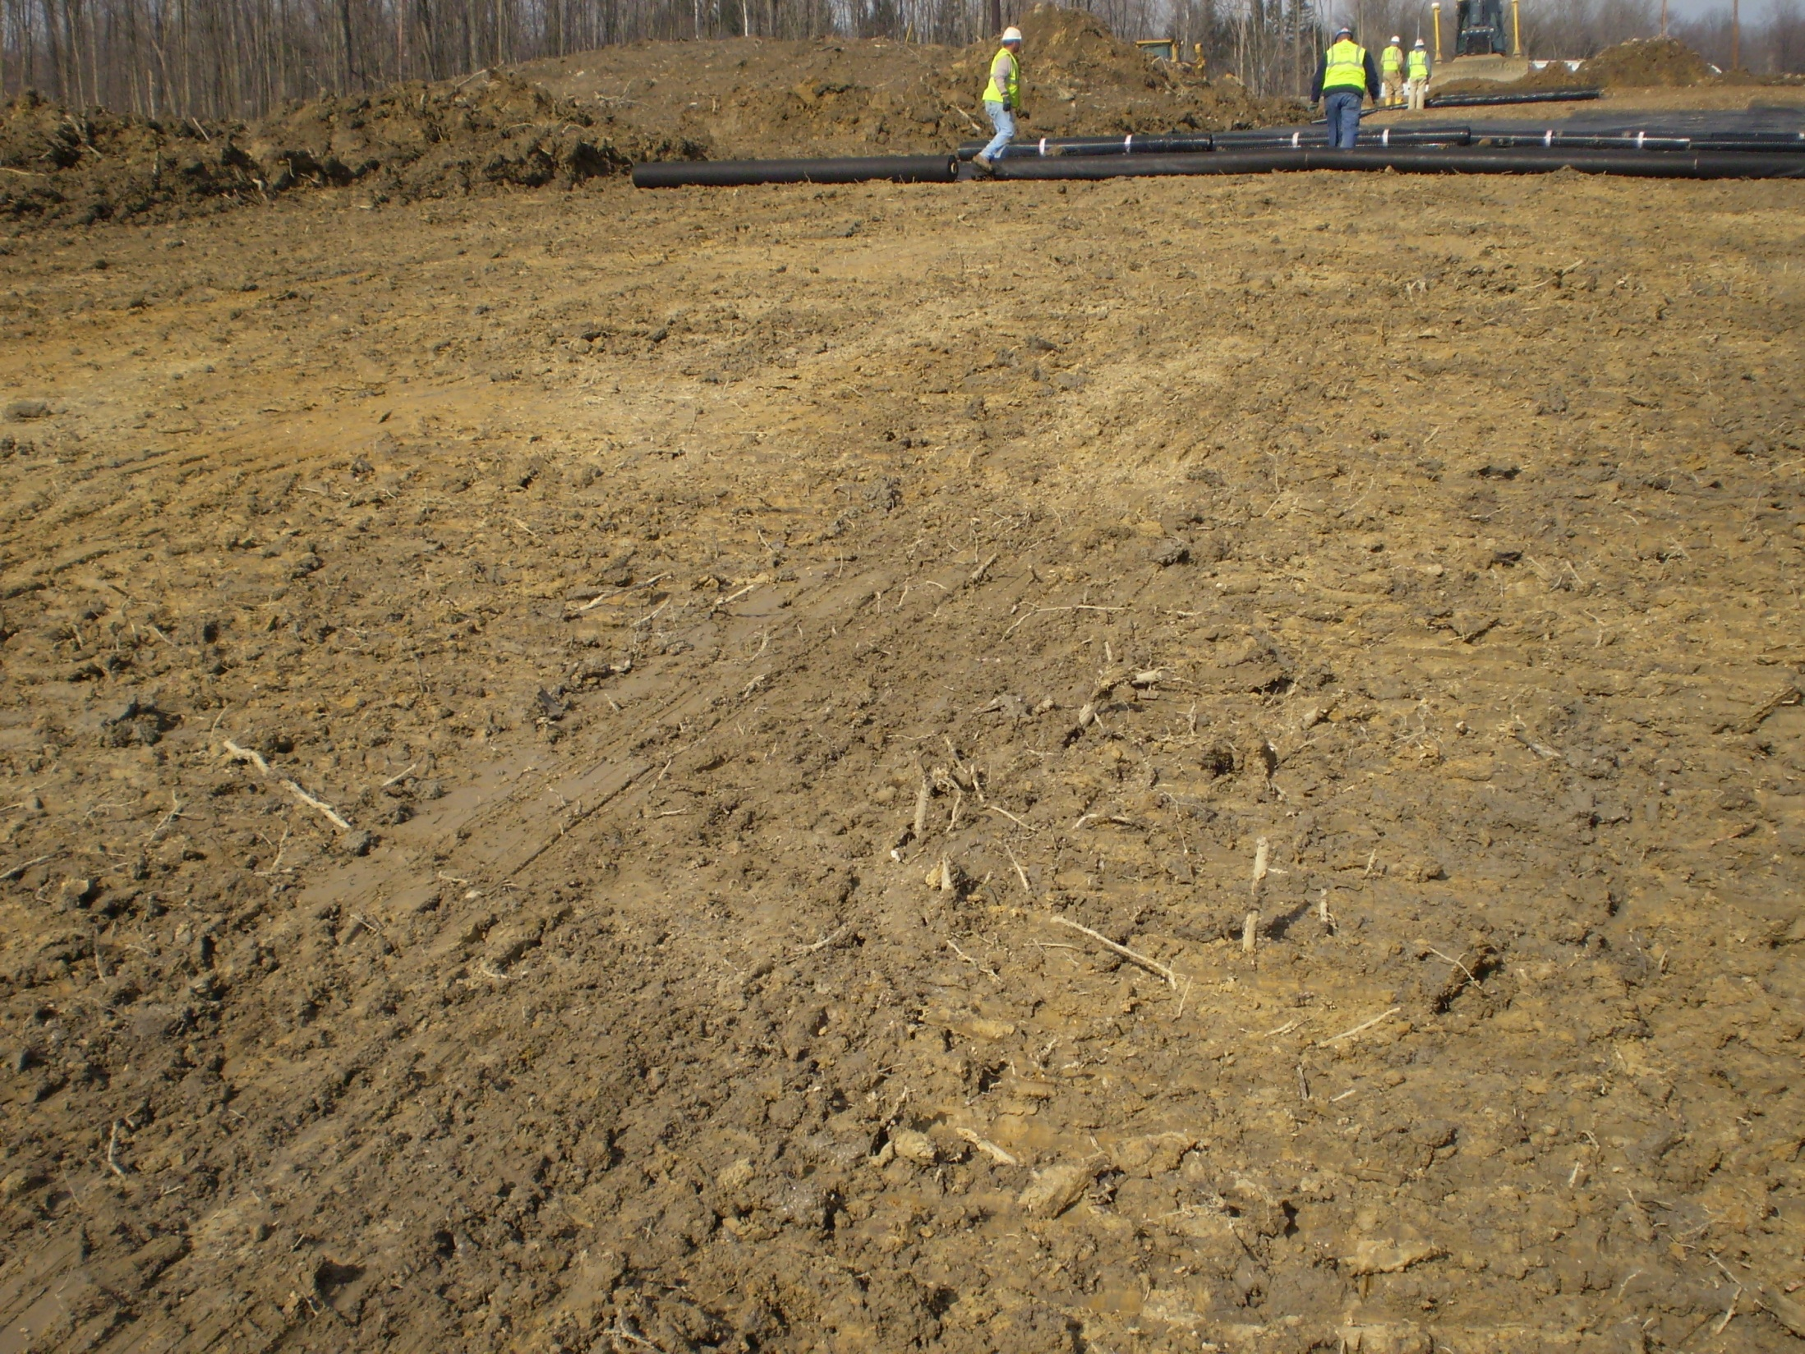

Slide 65
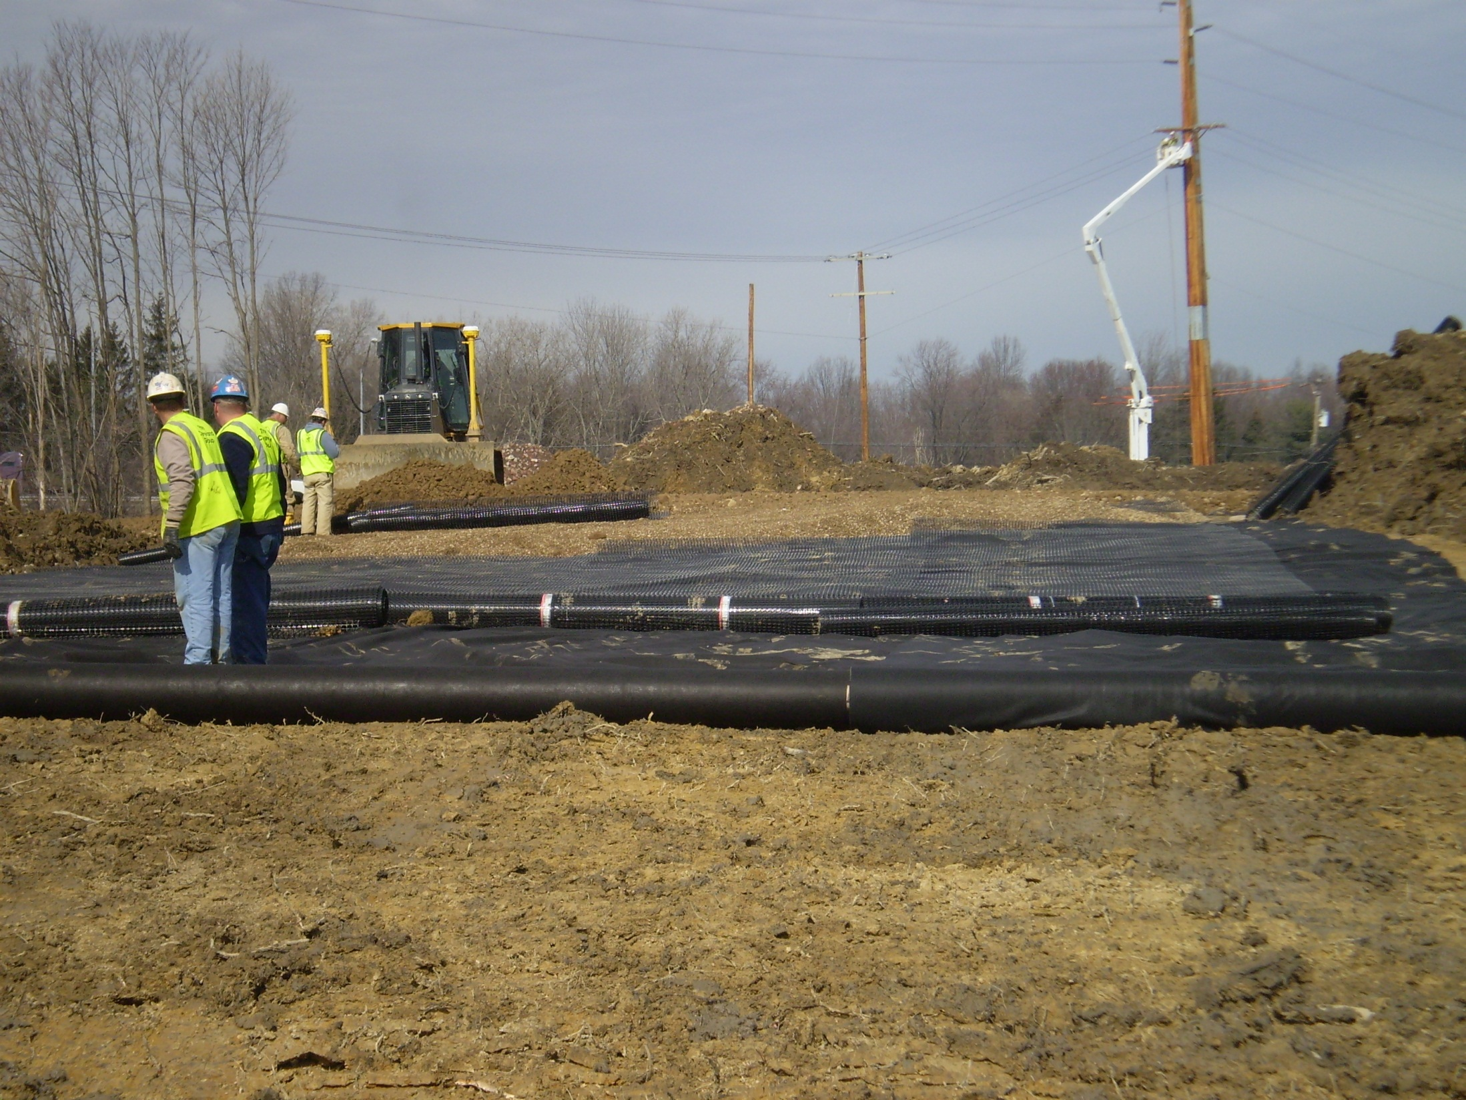

Slide 66
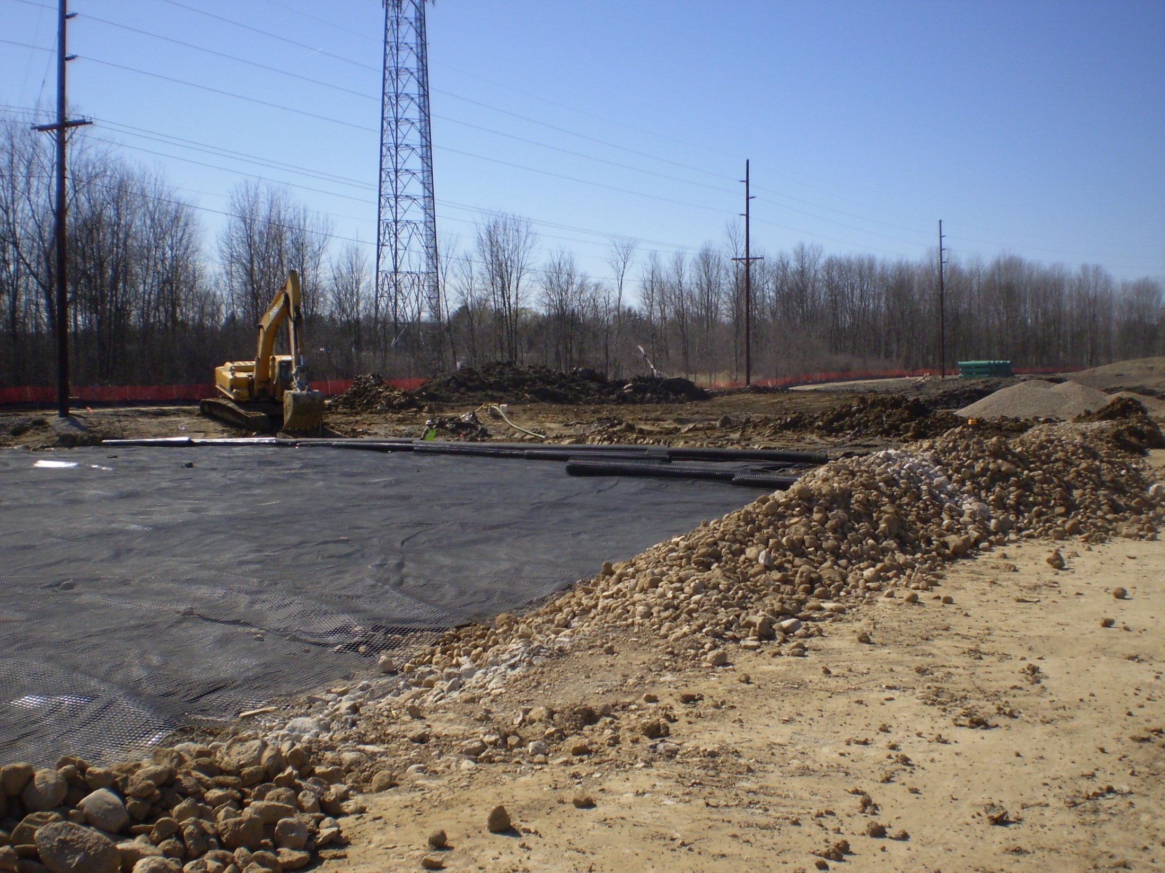

Slide 67
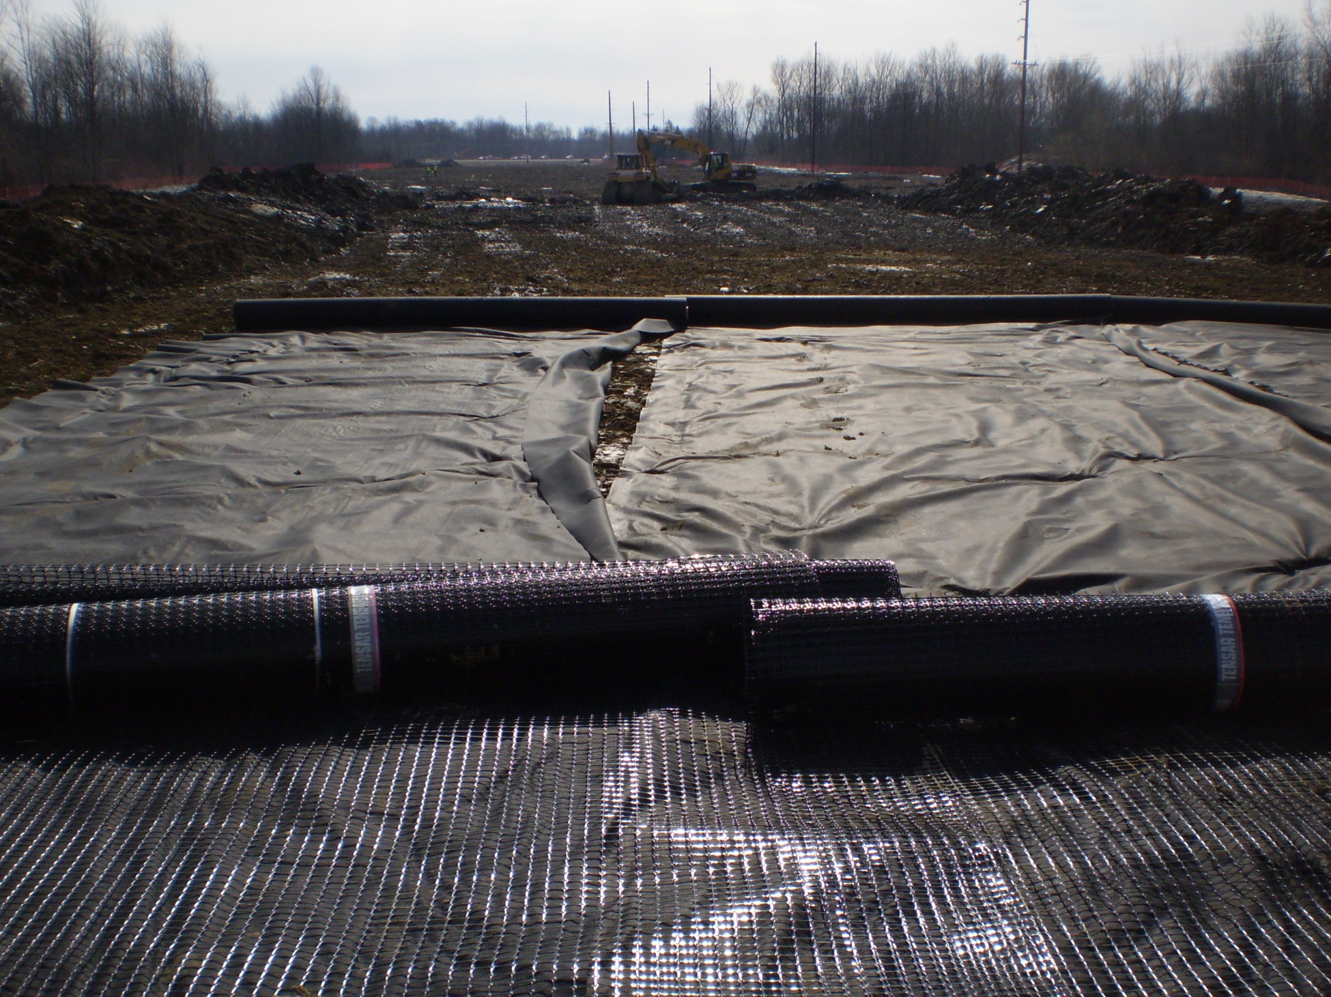

Slide 68
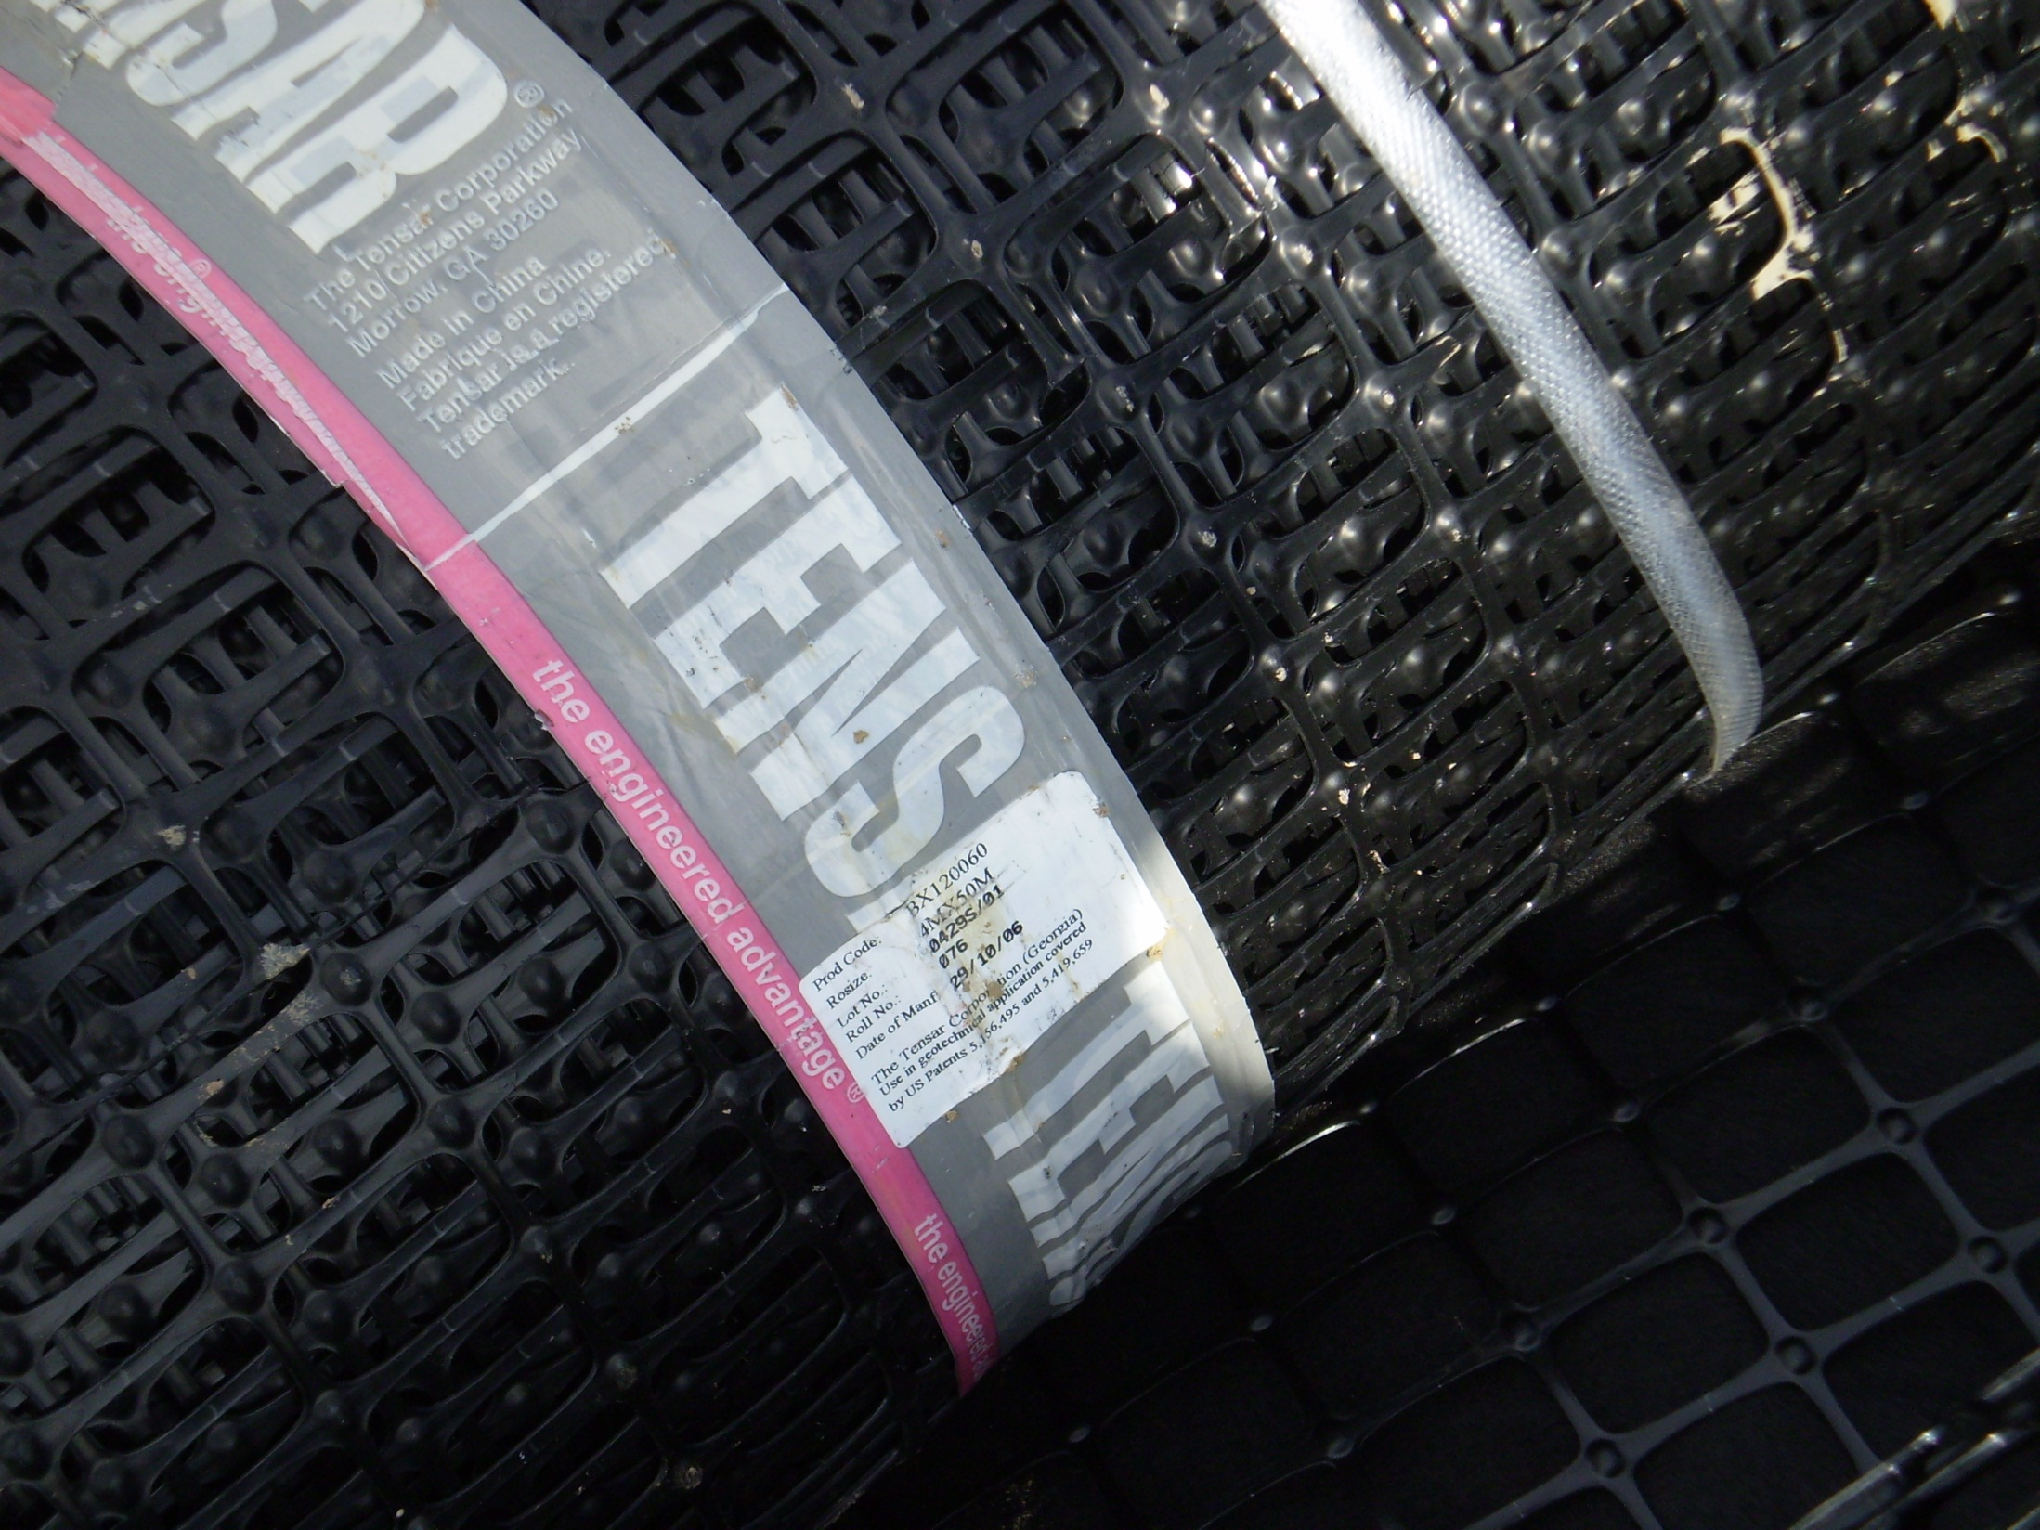

Slide 69
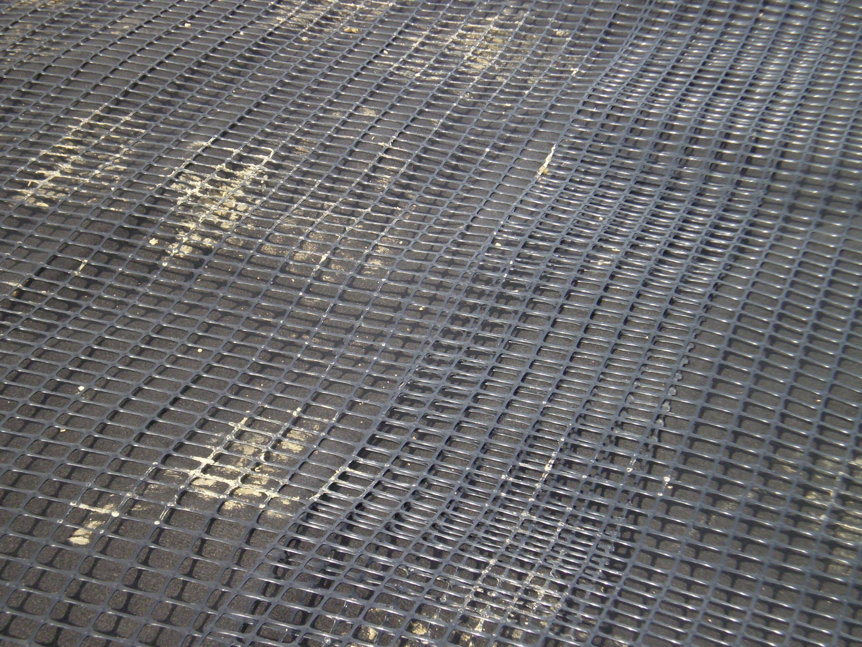

Slide 70
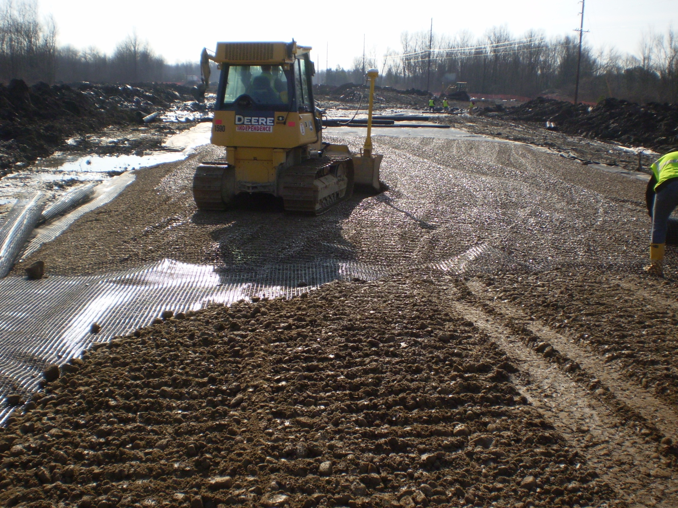

Slide 71
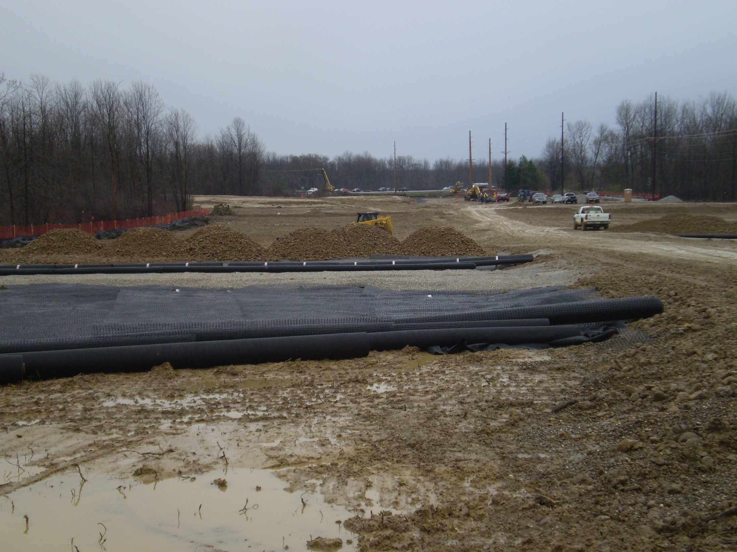

Slide 72
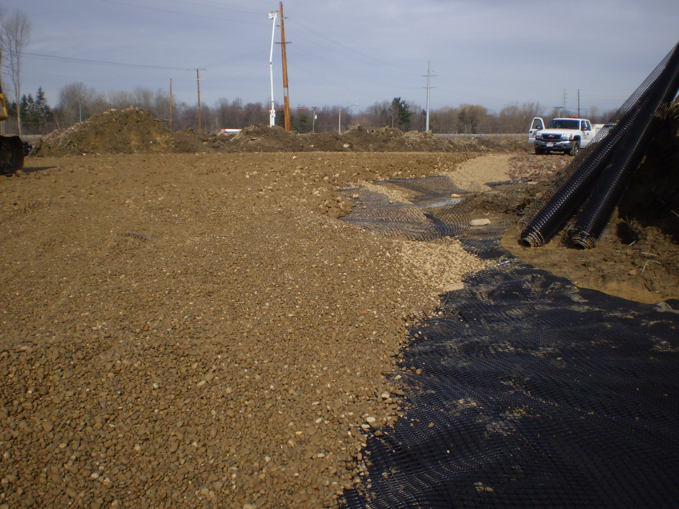

Slide 73
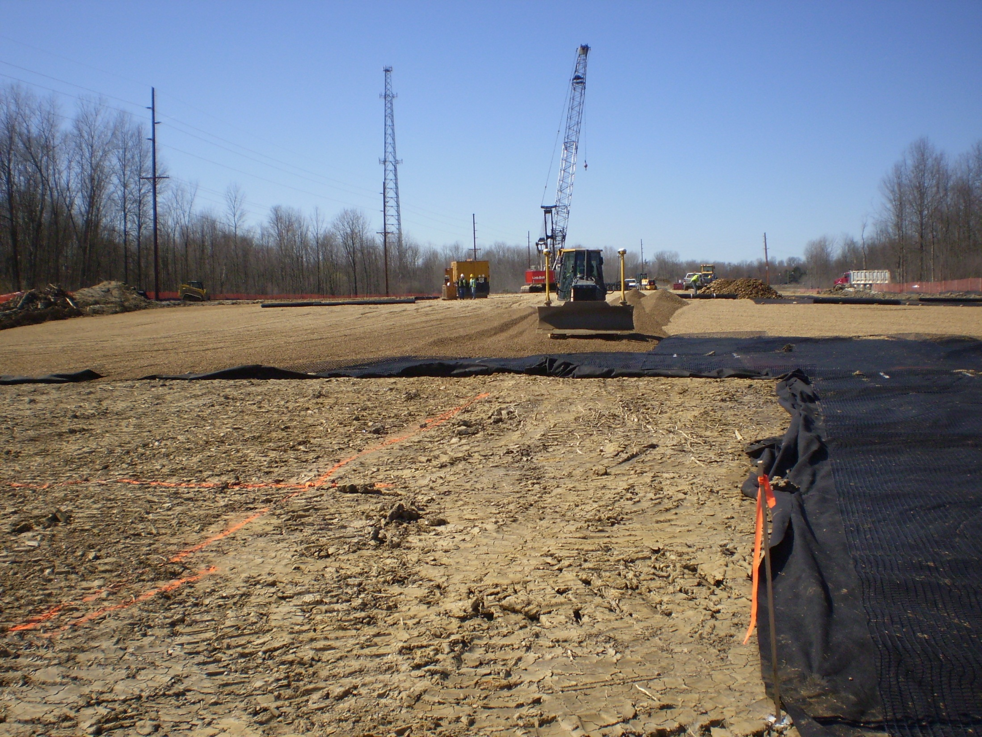

Slide 74
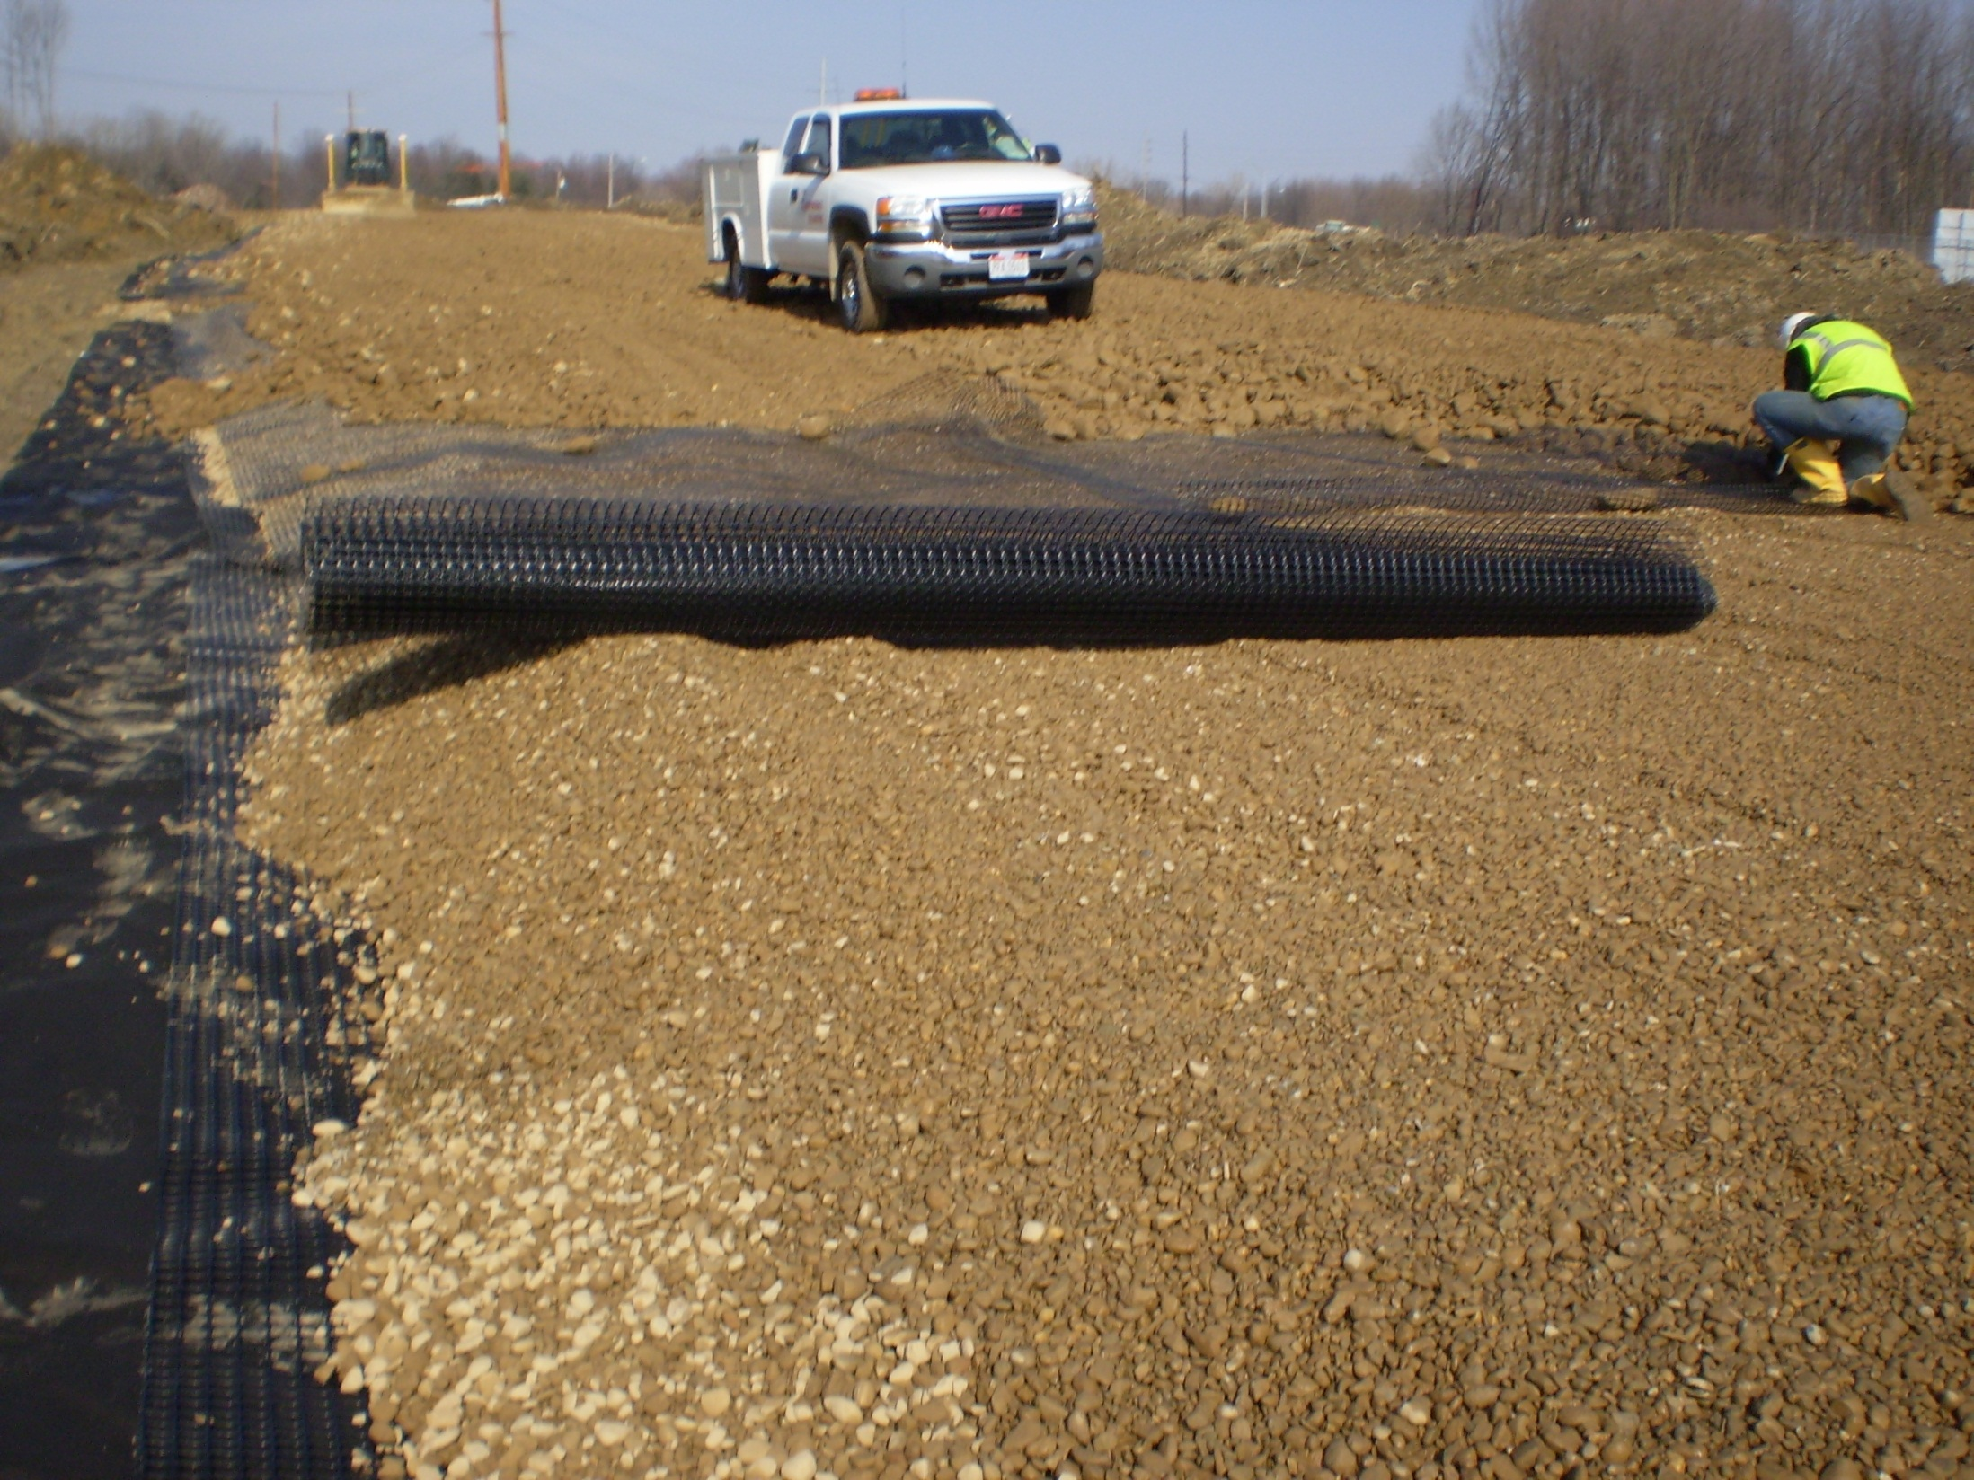

Slide 75
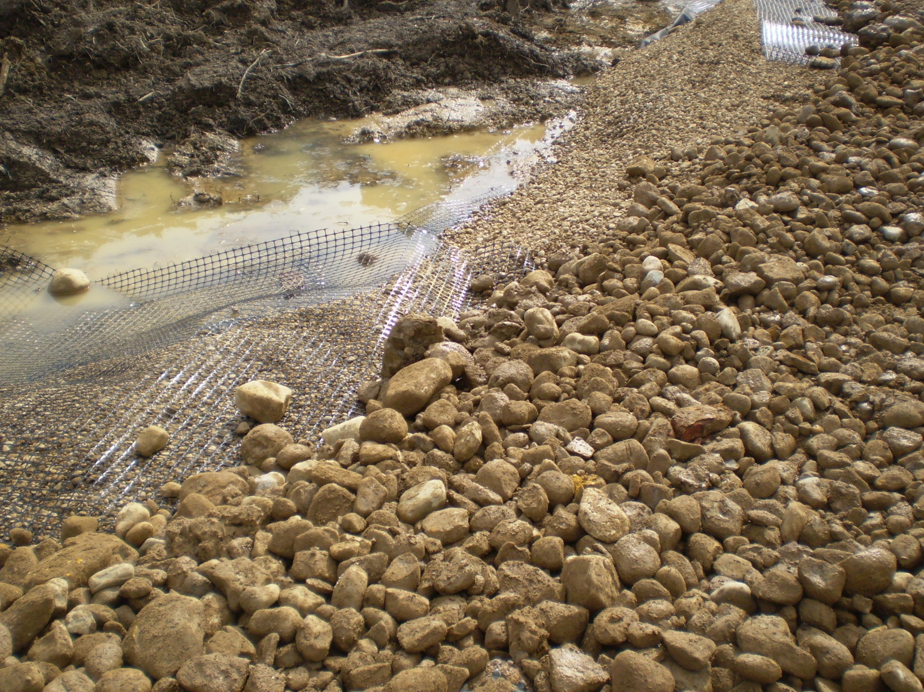

Slide 76
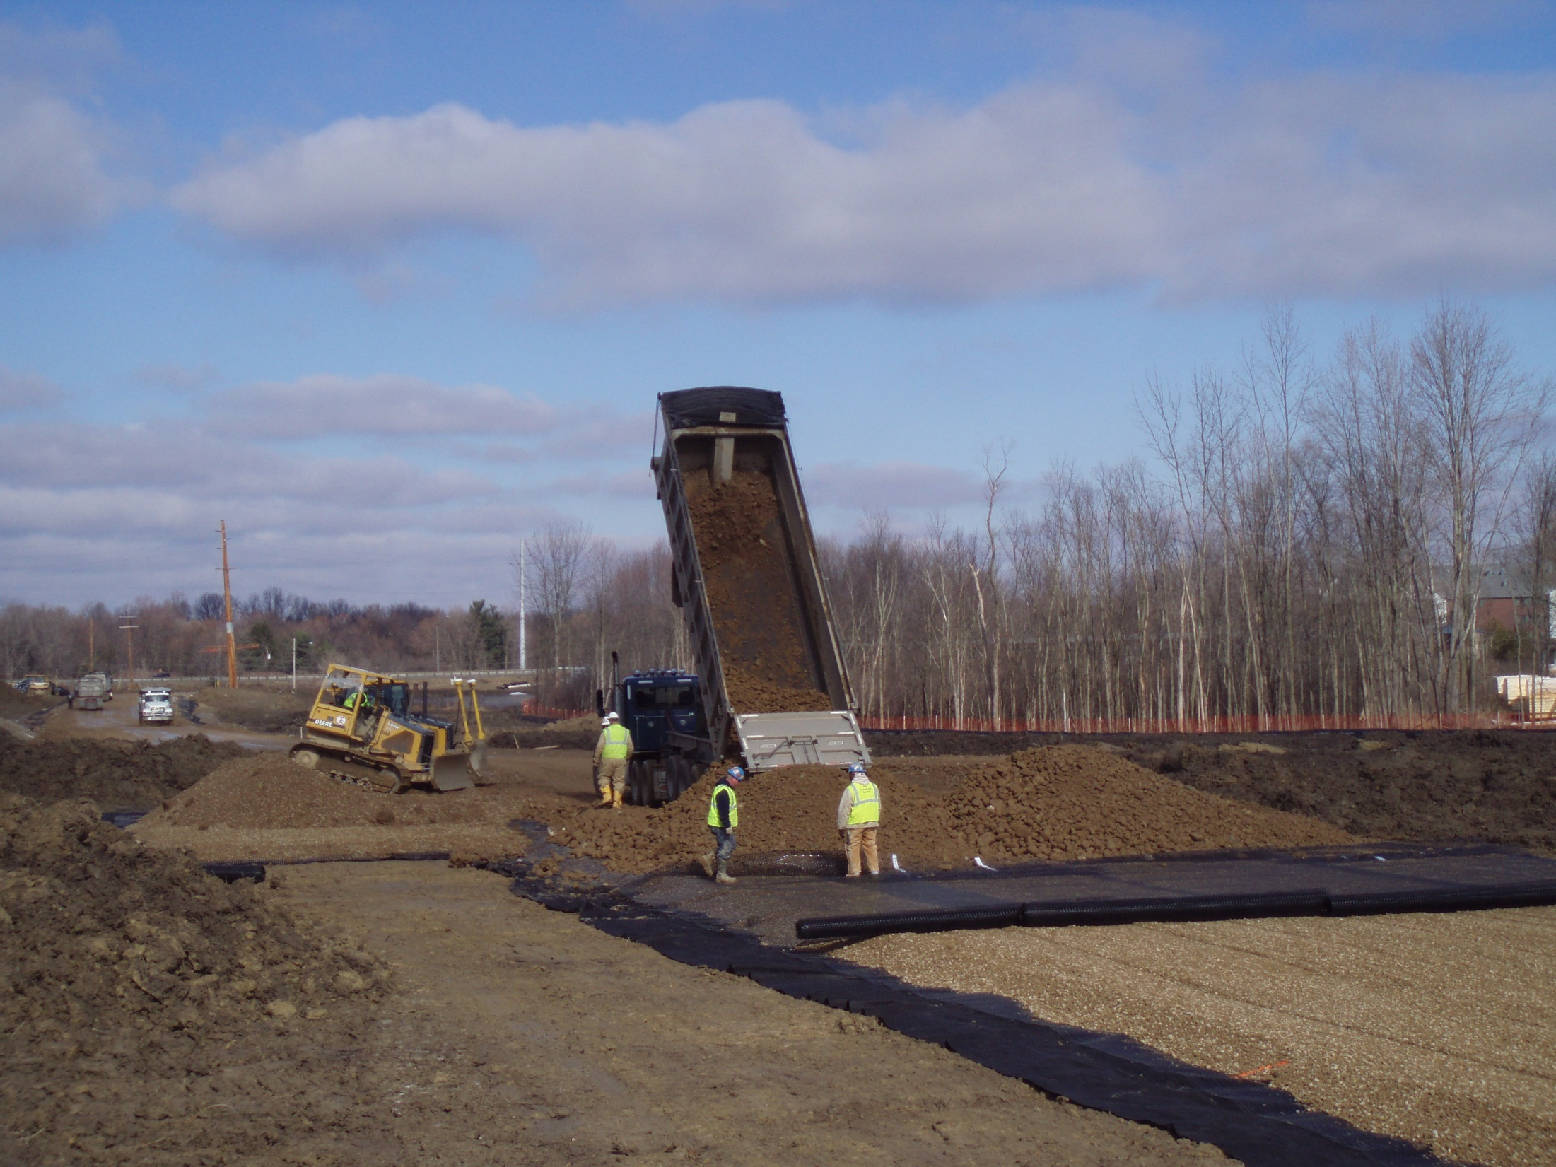

Slide 77
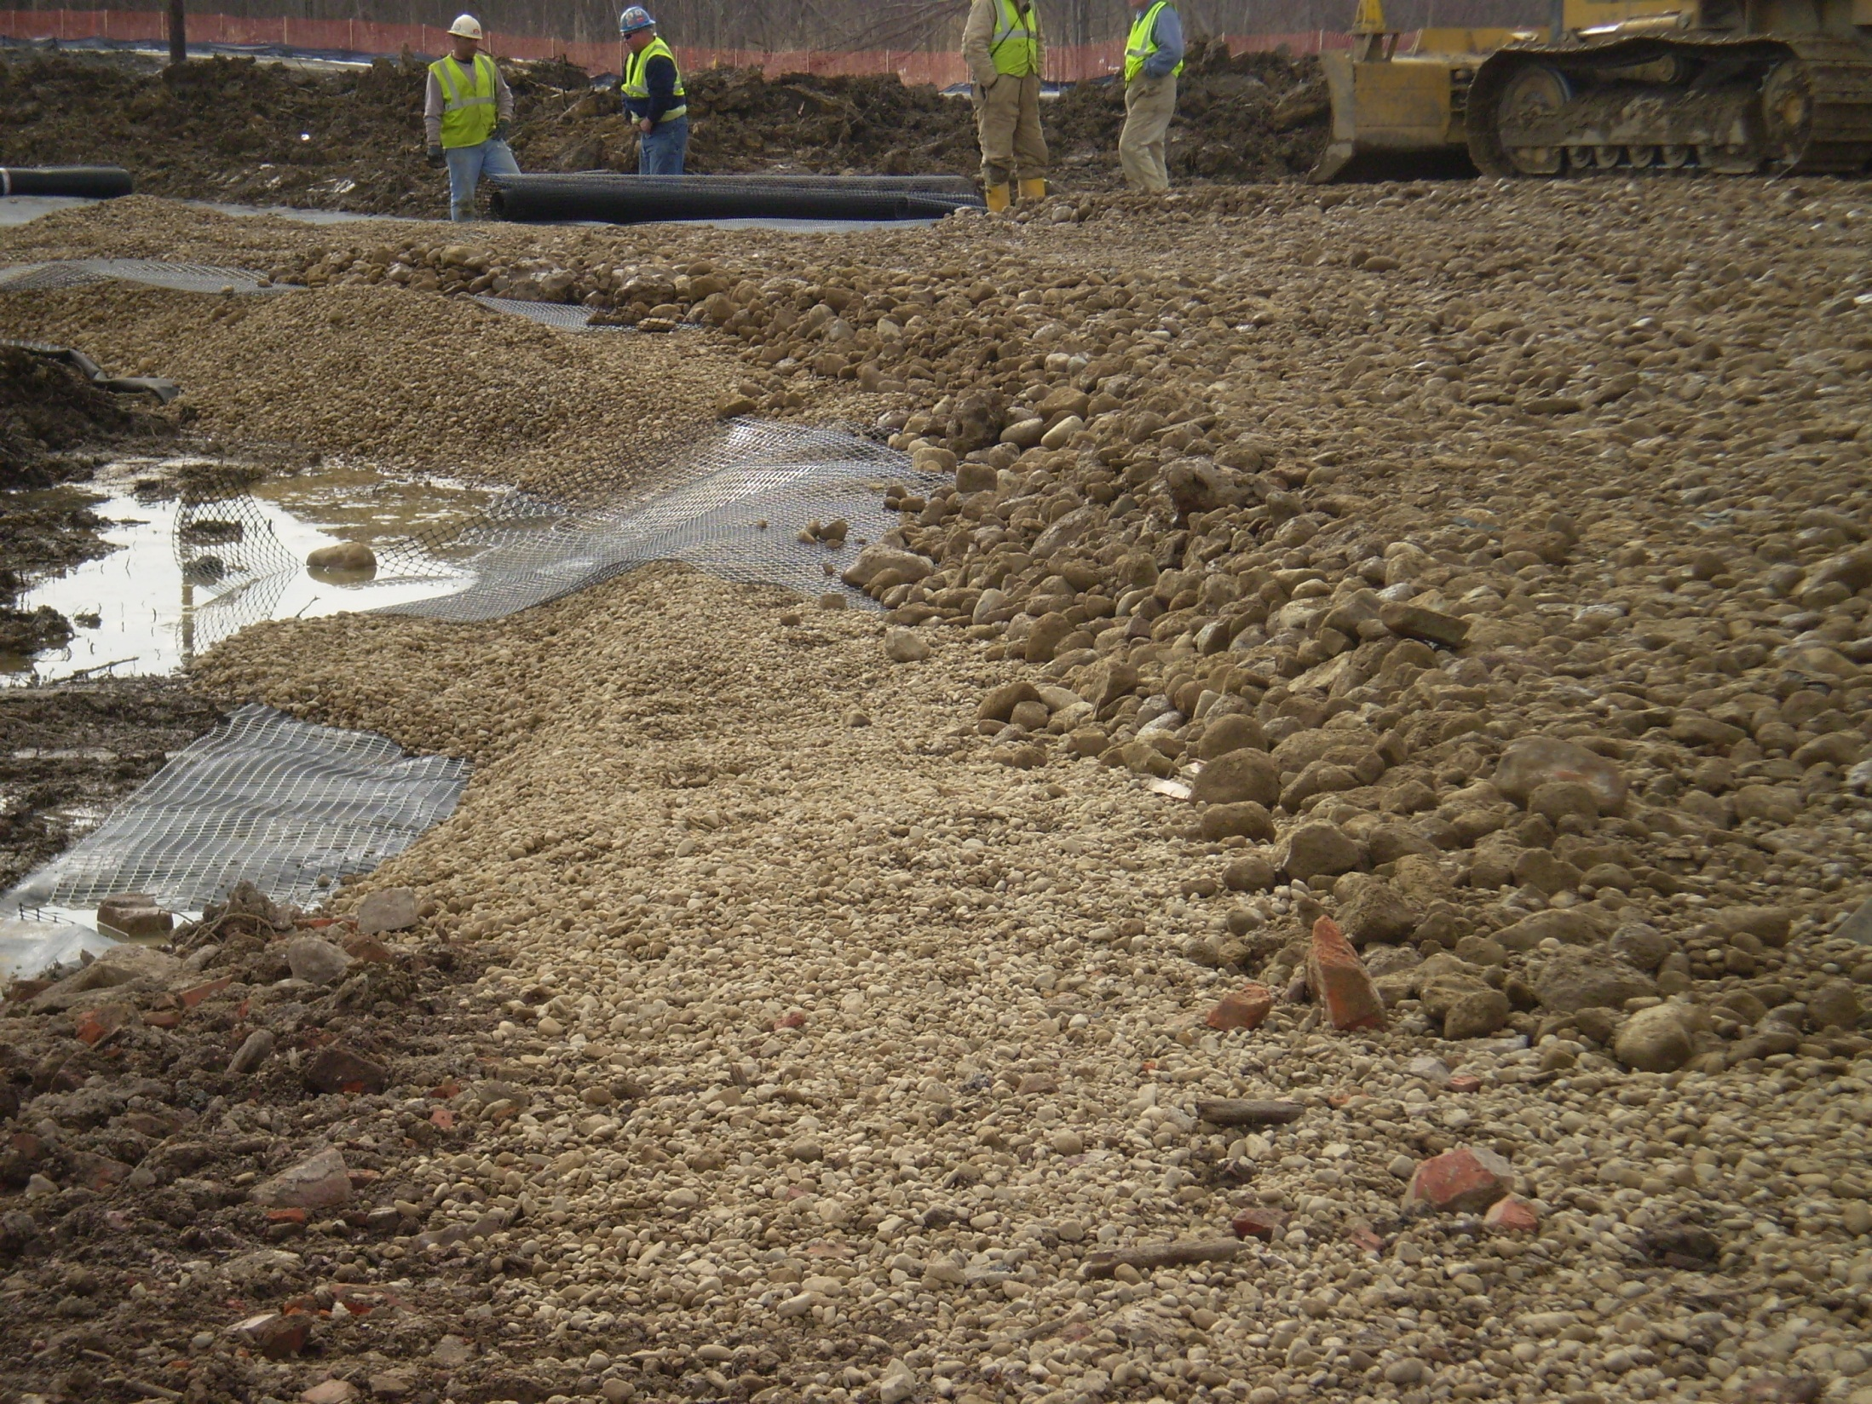

Slide 78
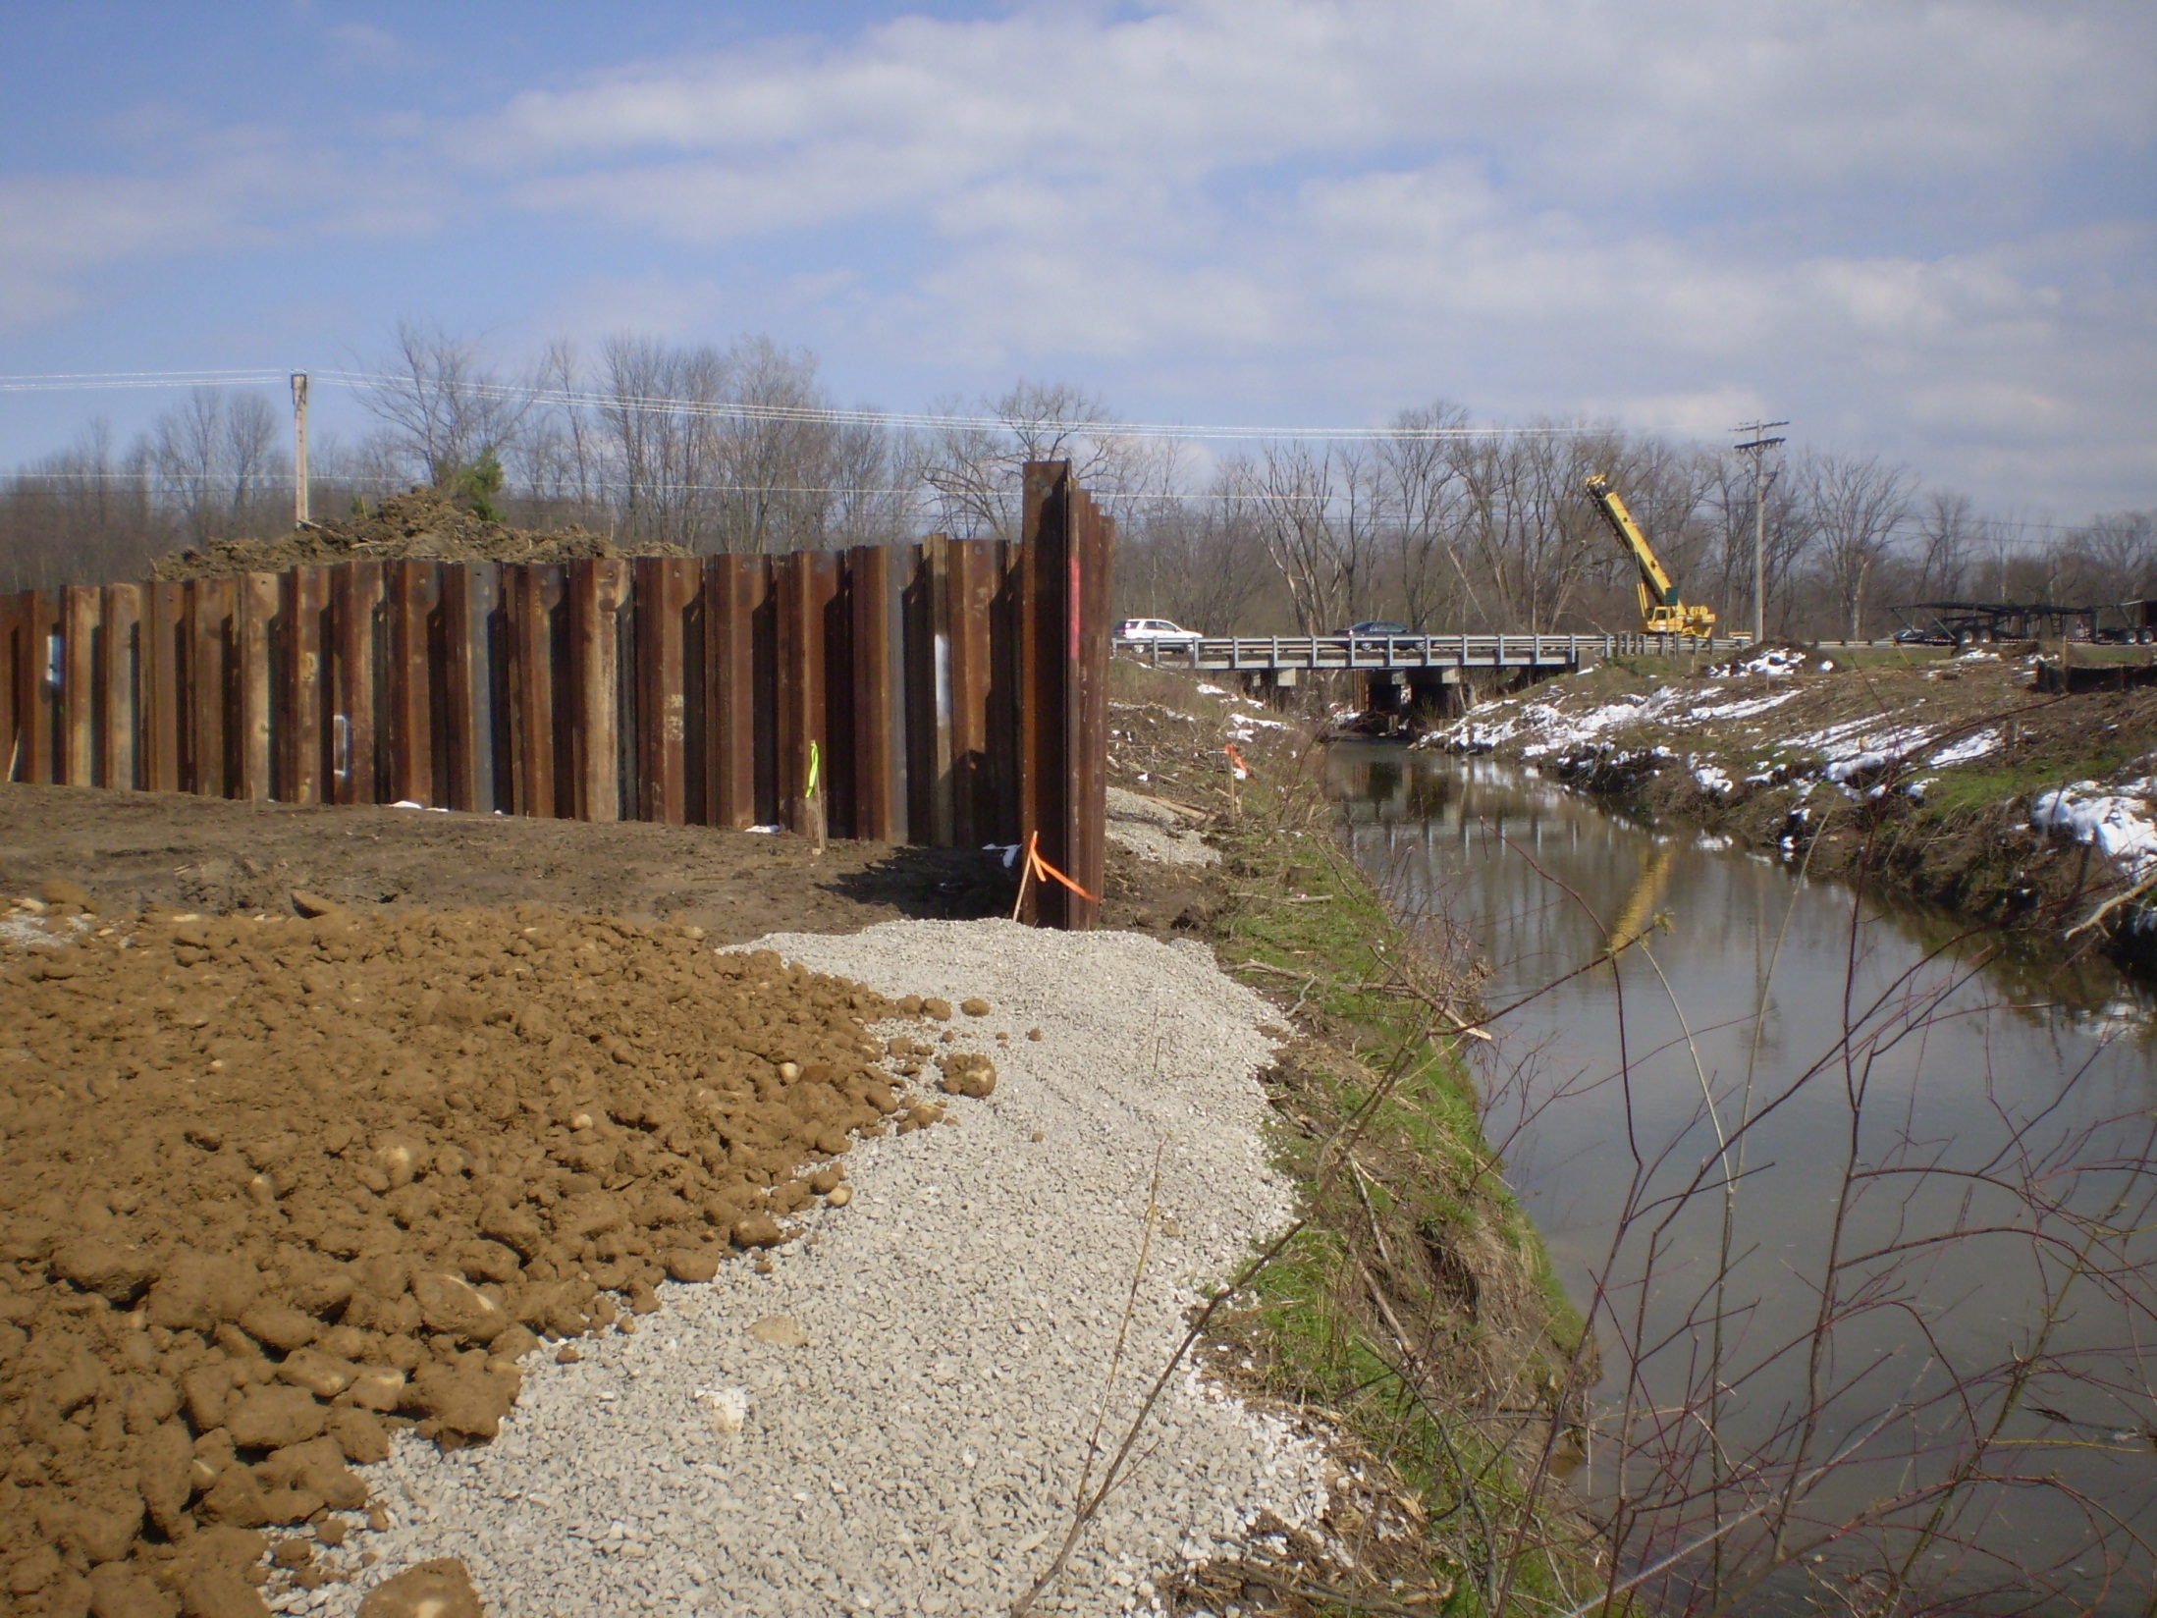

Slide 79
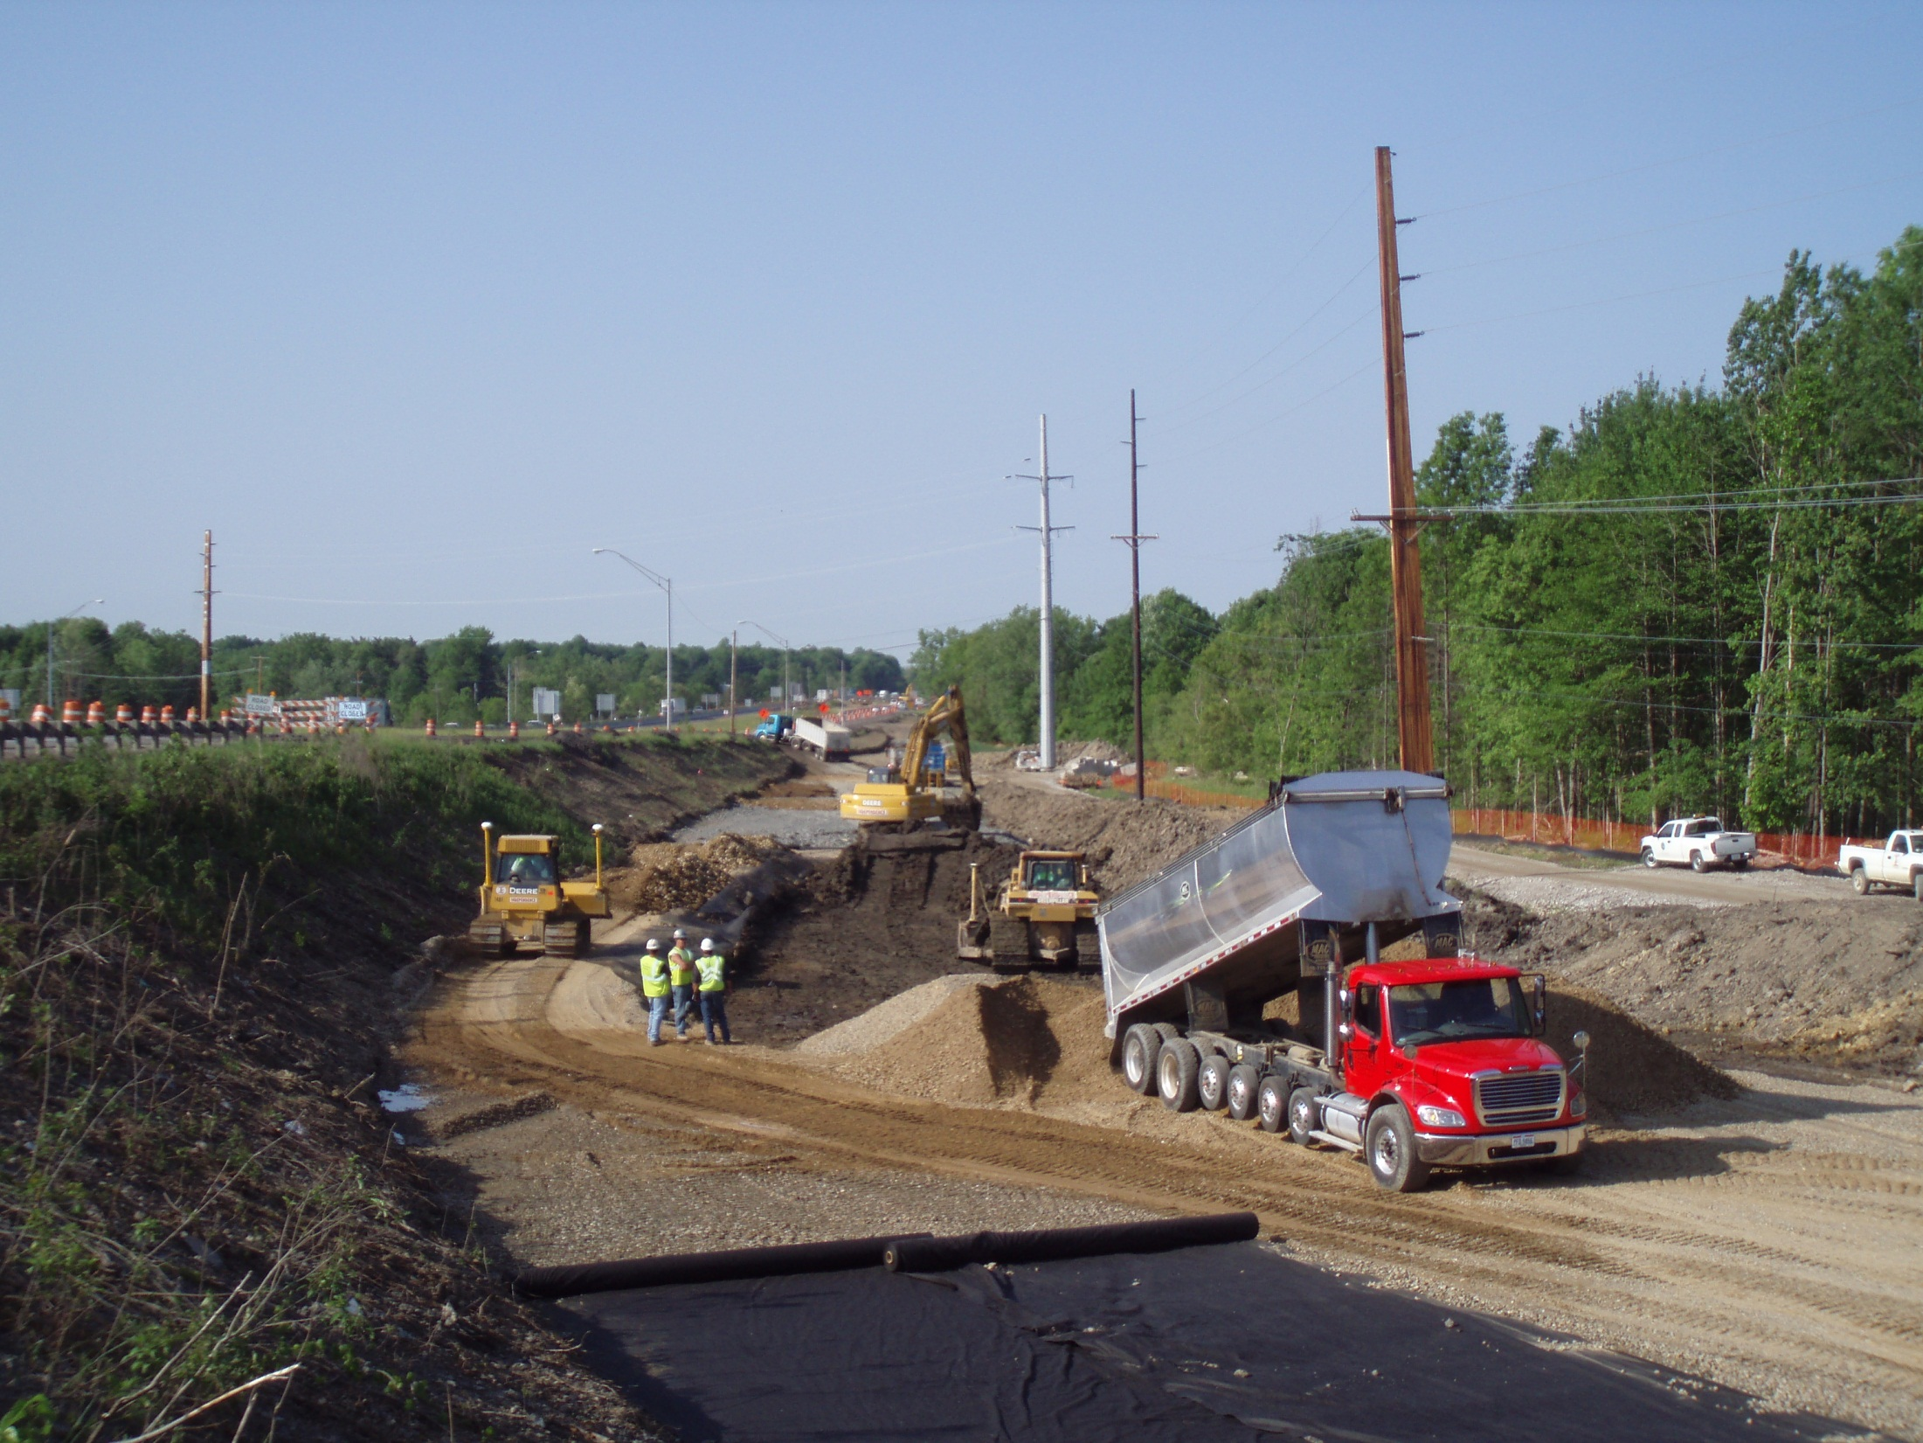

Slide 80
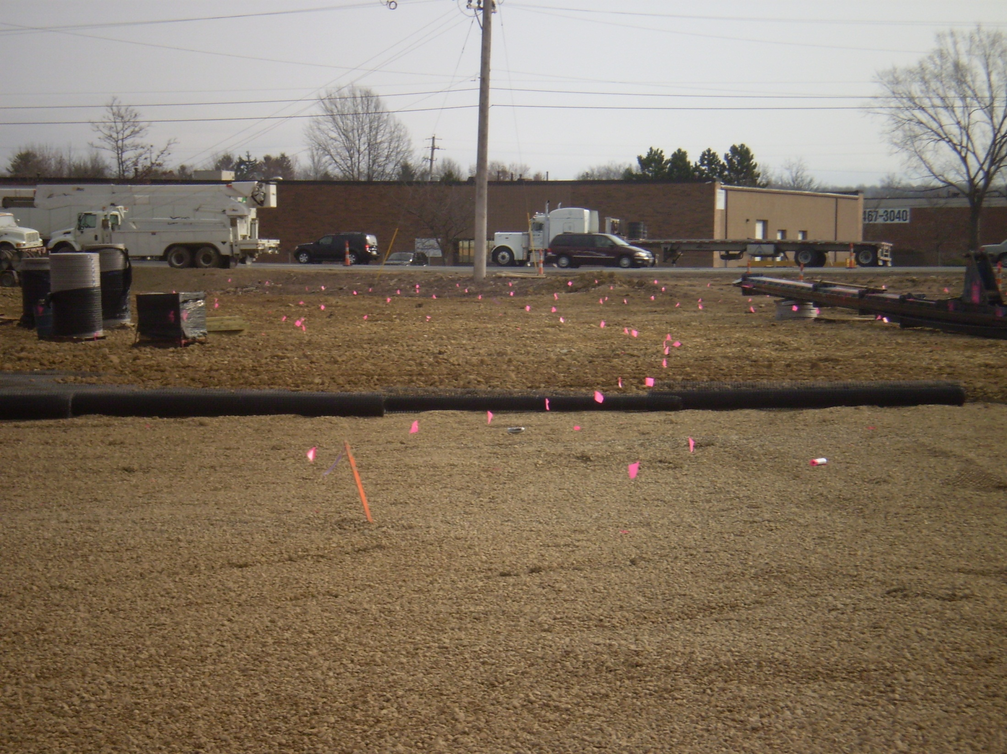

Slide 81
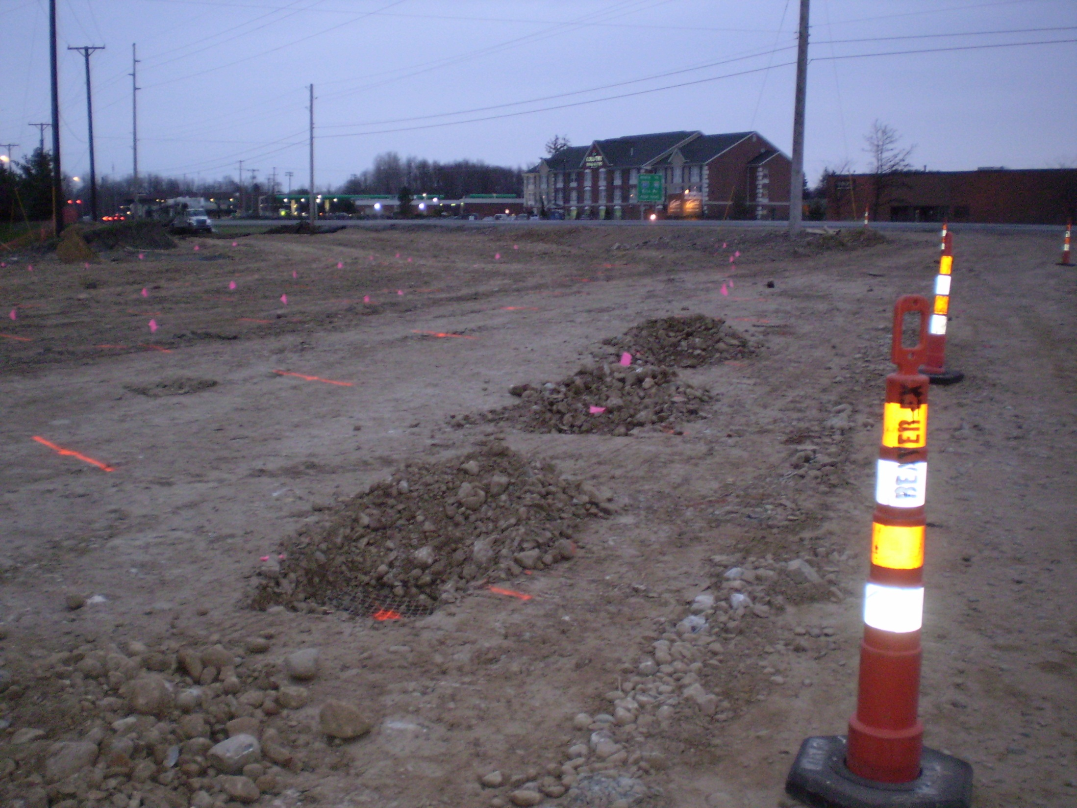

Slide 82
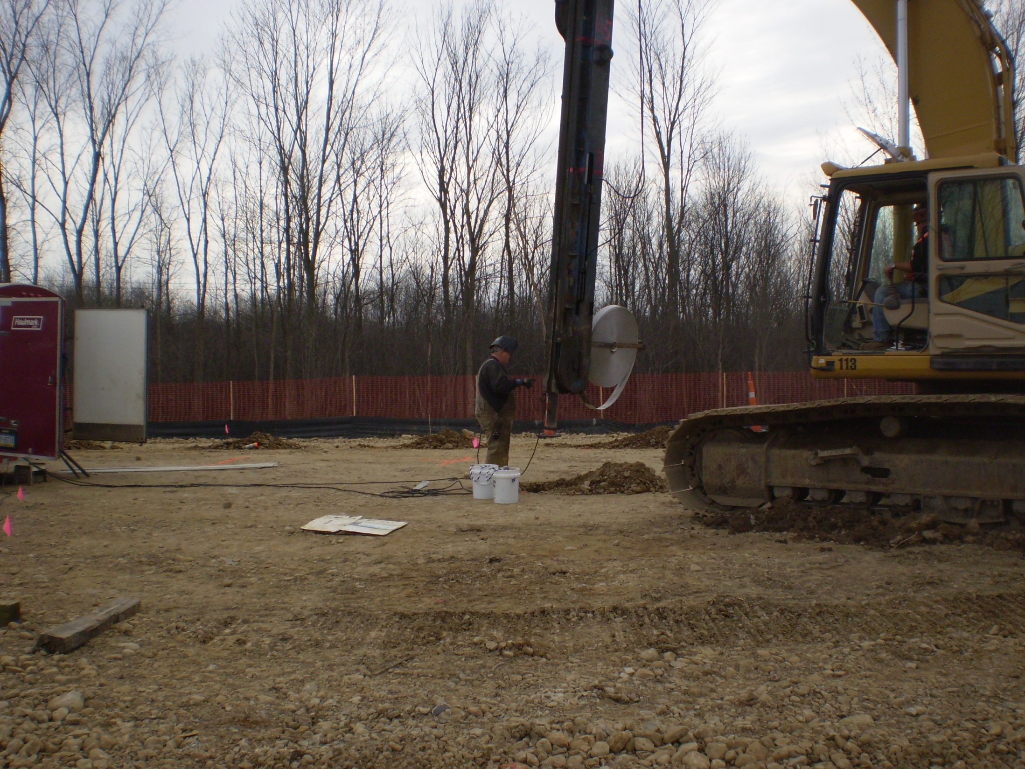

Slide 83
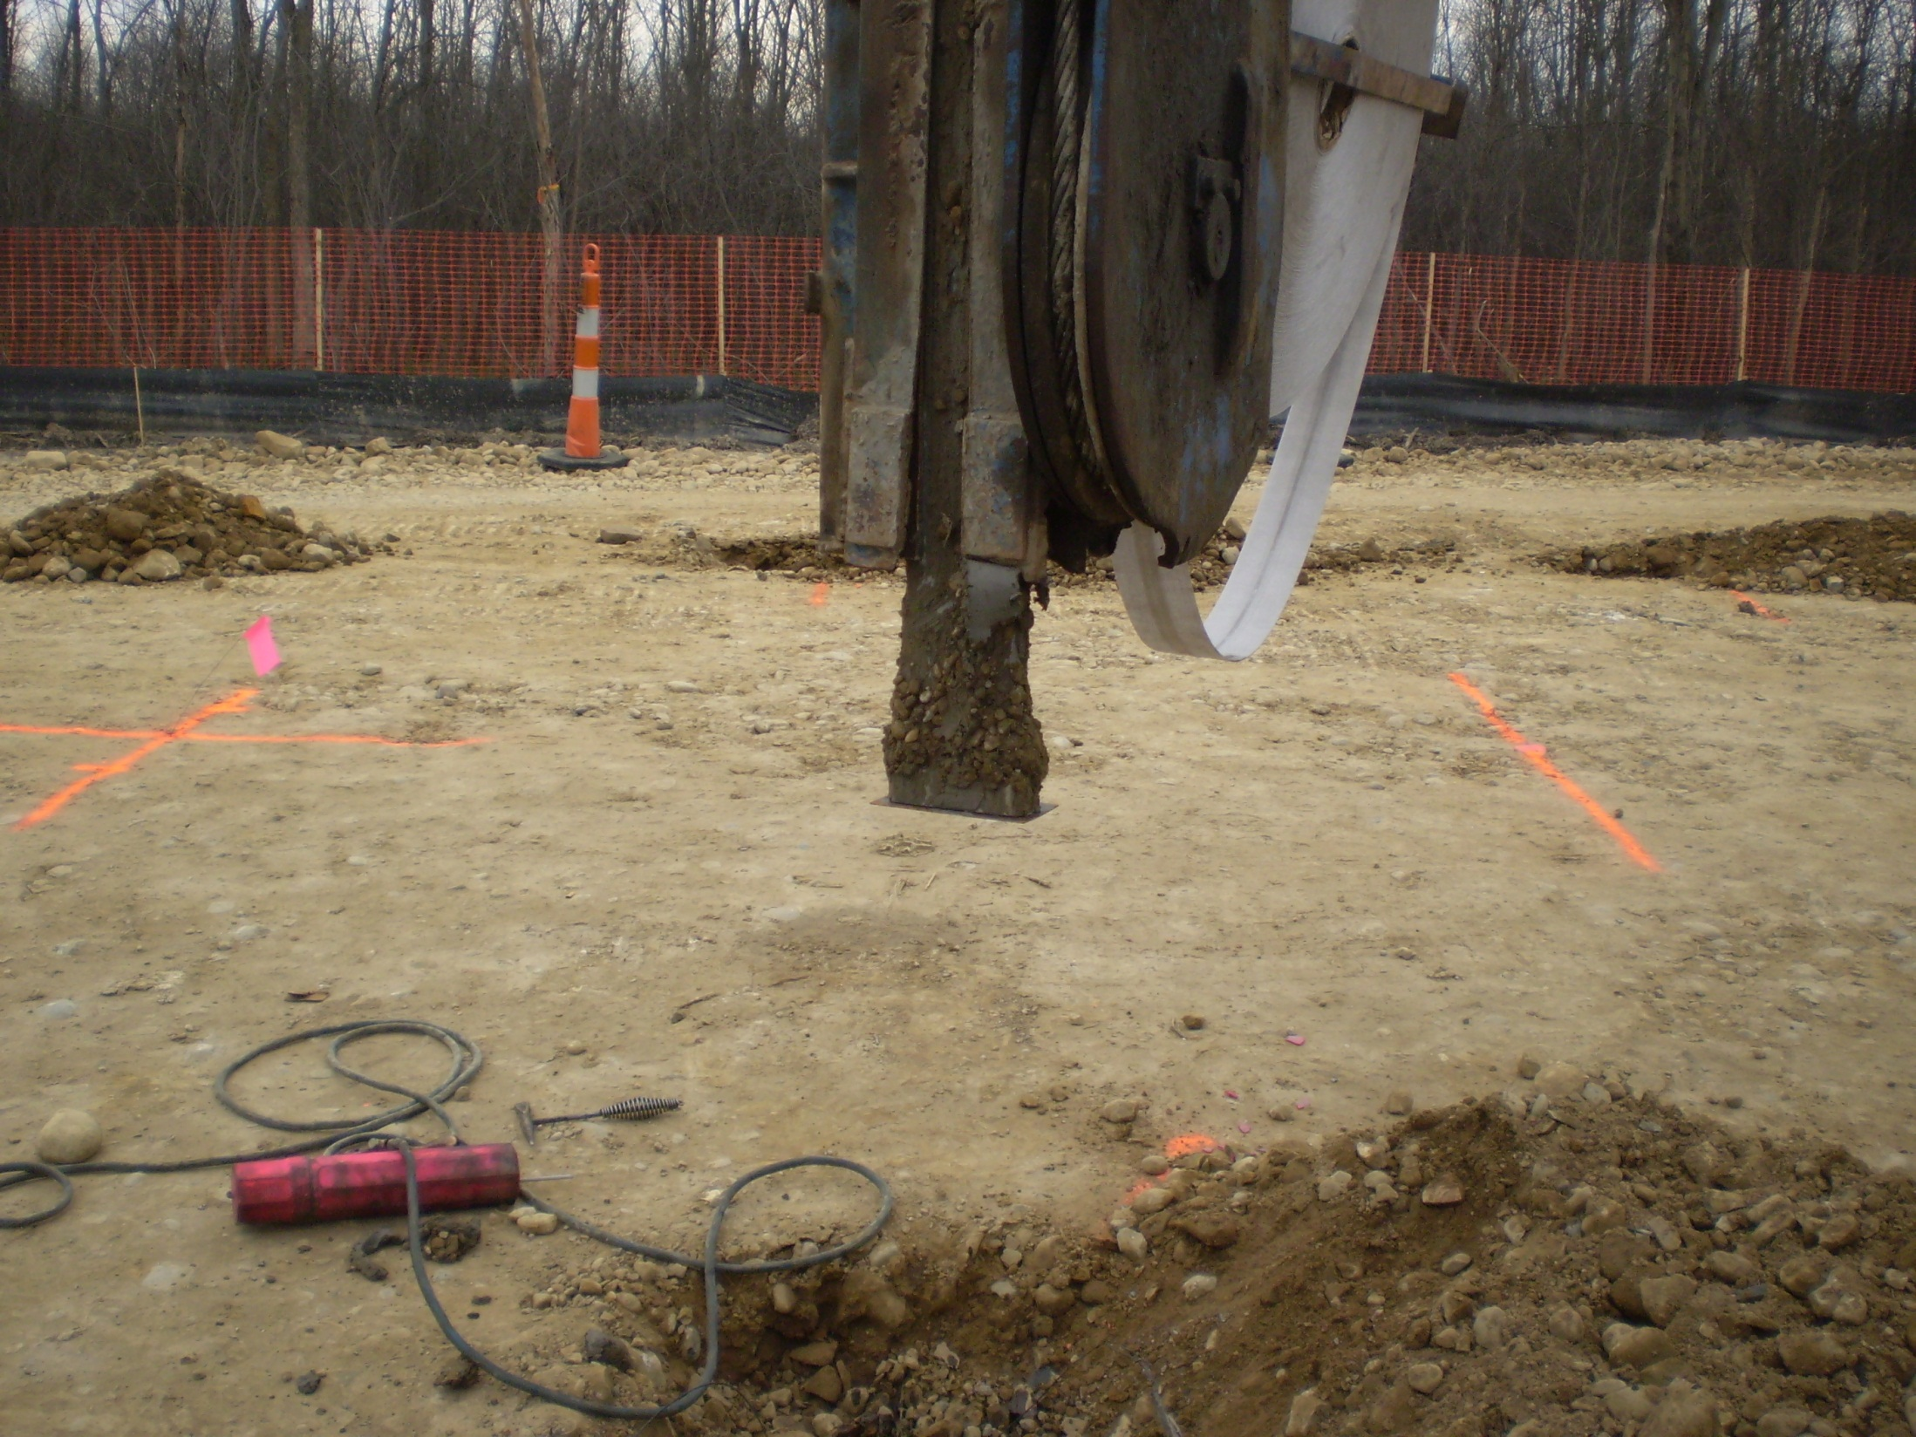

Slide 84
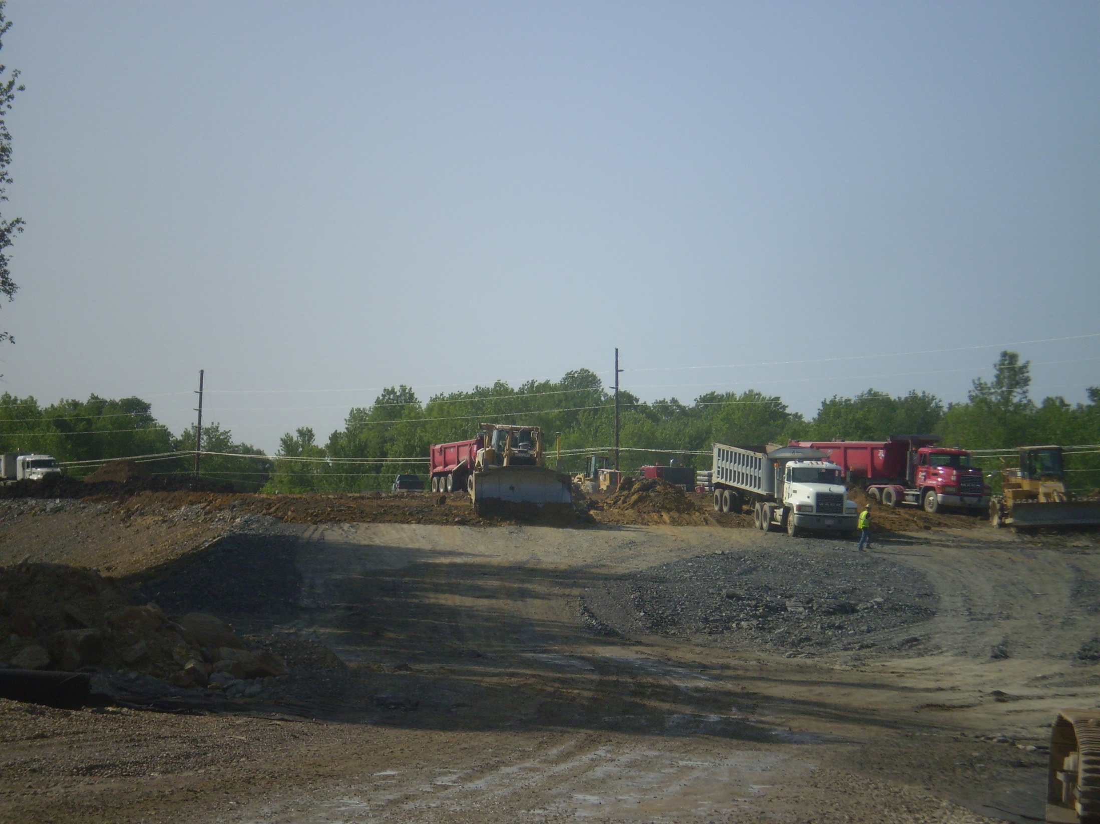

Slide 85
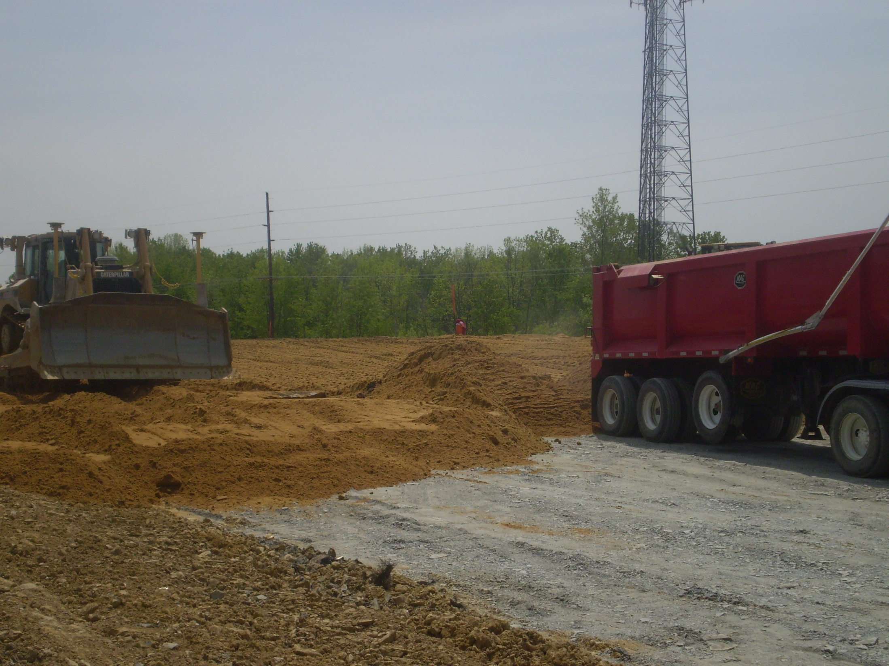

Slide 86
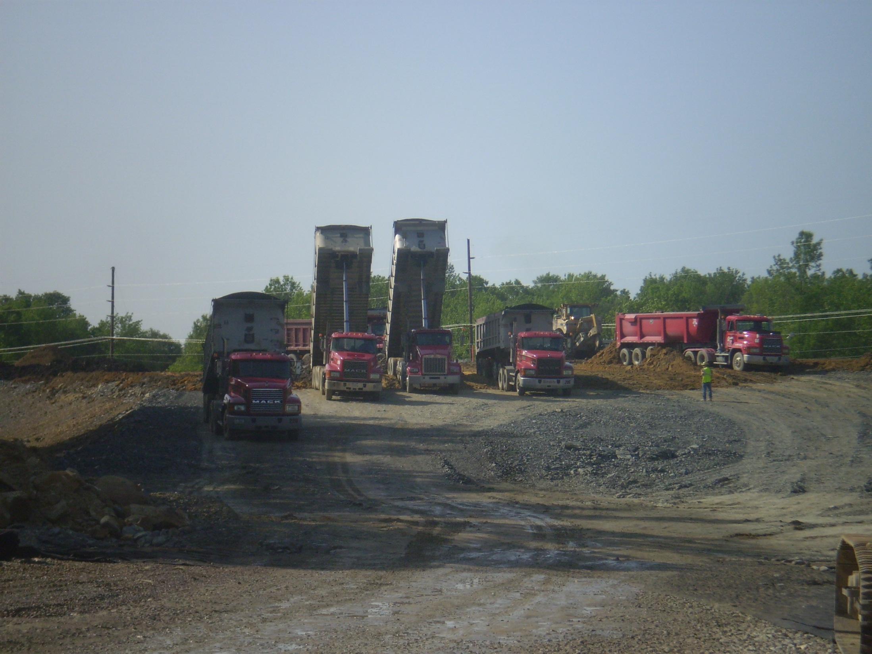

Slide 87
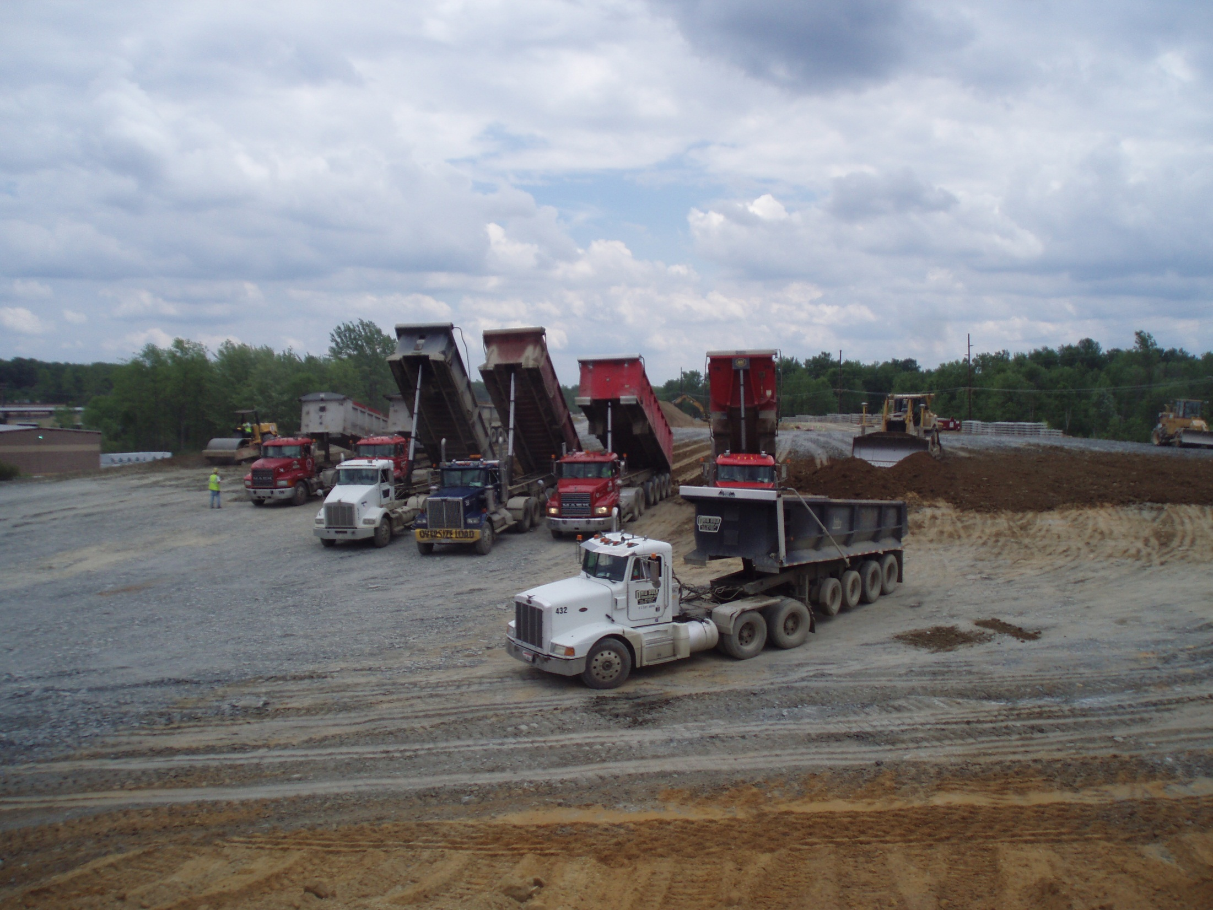

Slide 88
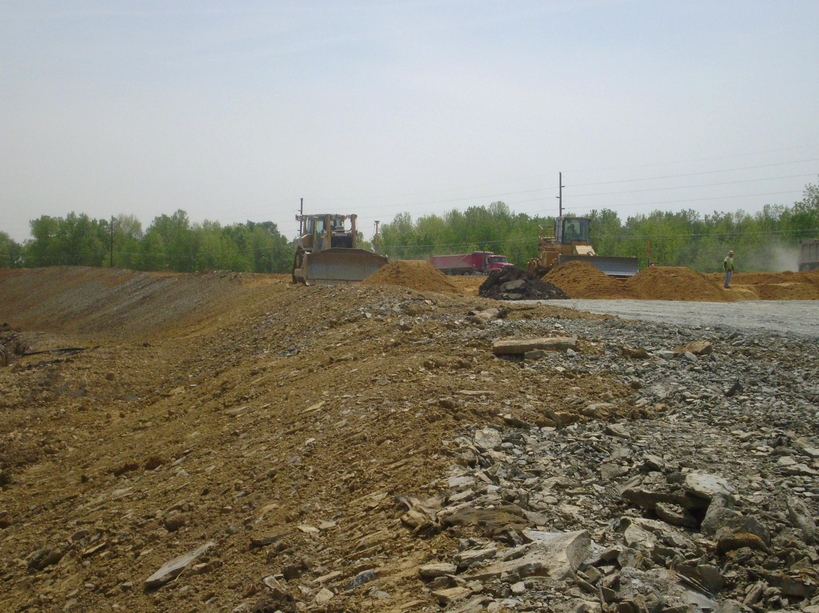

Slide 89
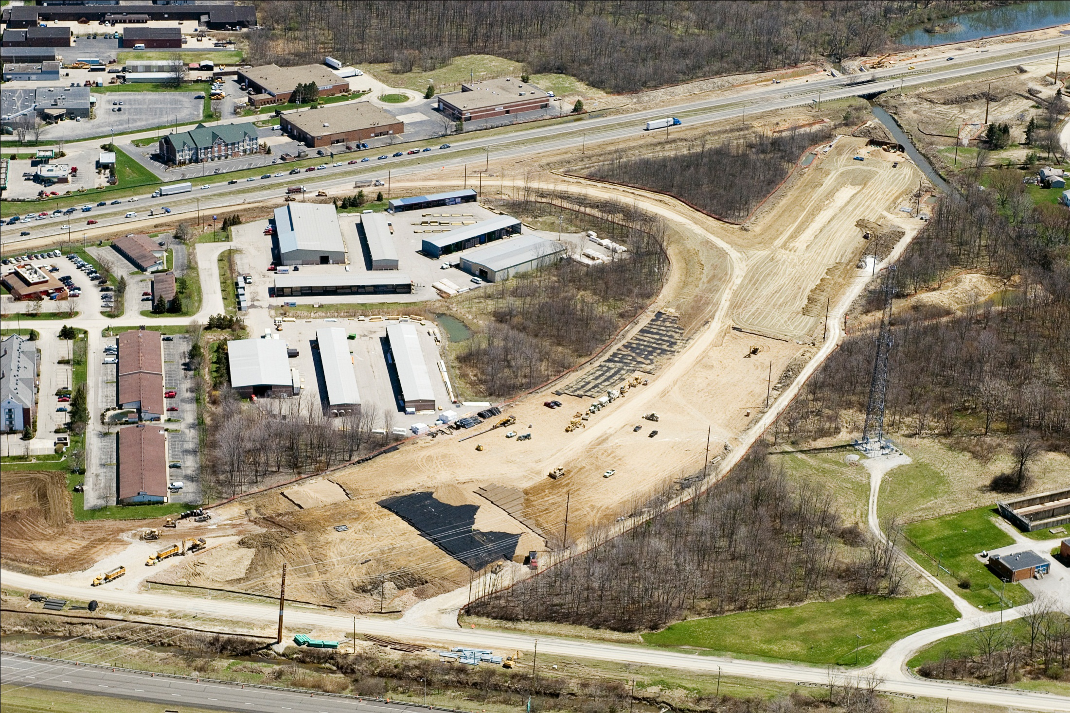

Slide 90
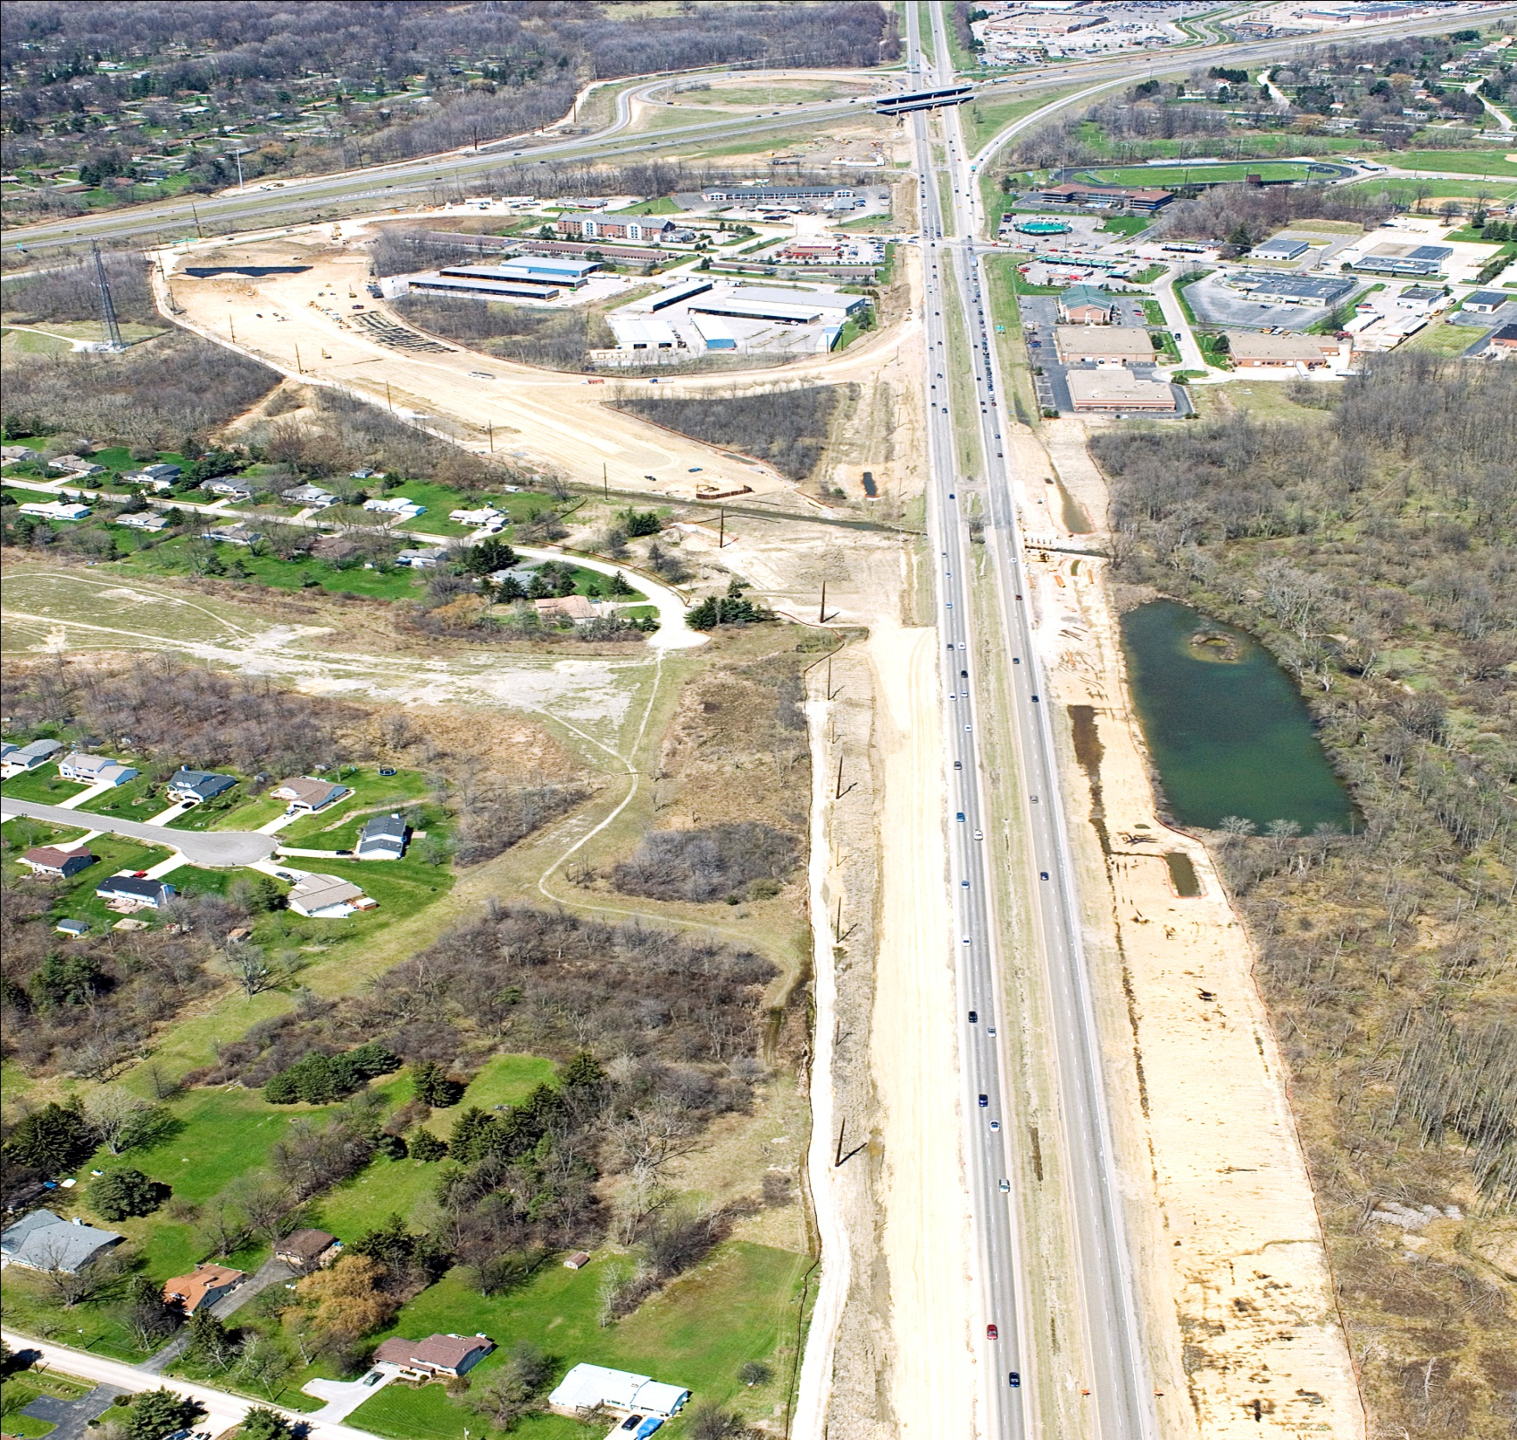

Slide 91
June 2007Looking NB 8 /Ramp A,B to left

Slide 92
January 2008 I271 bottom/ Ramp A-B at the top

Slide 93
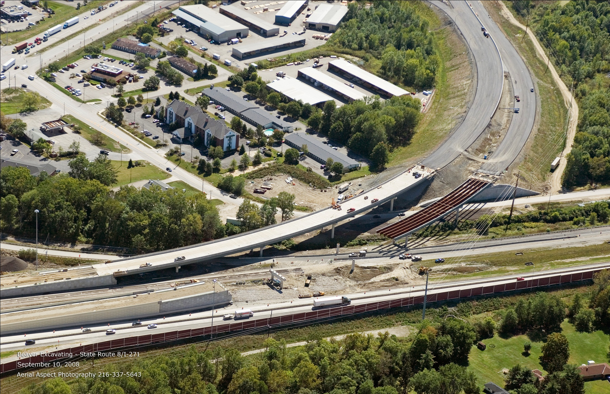

Slide 94
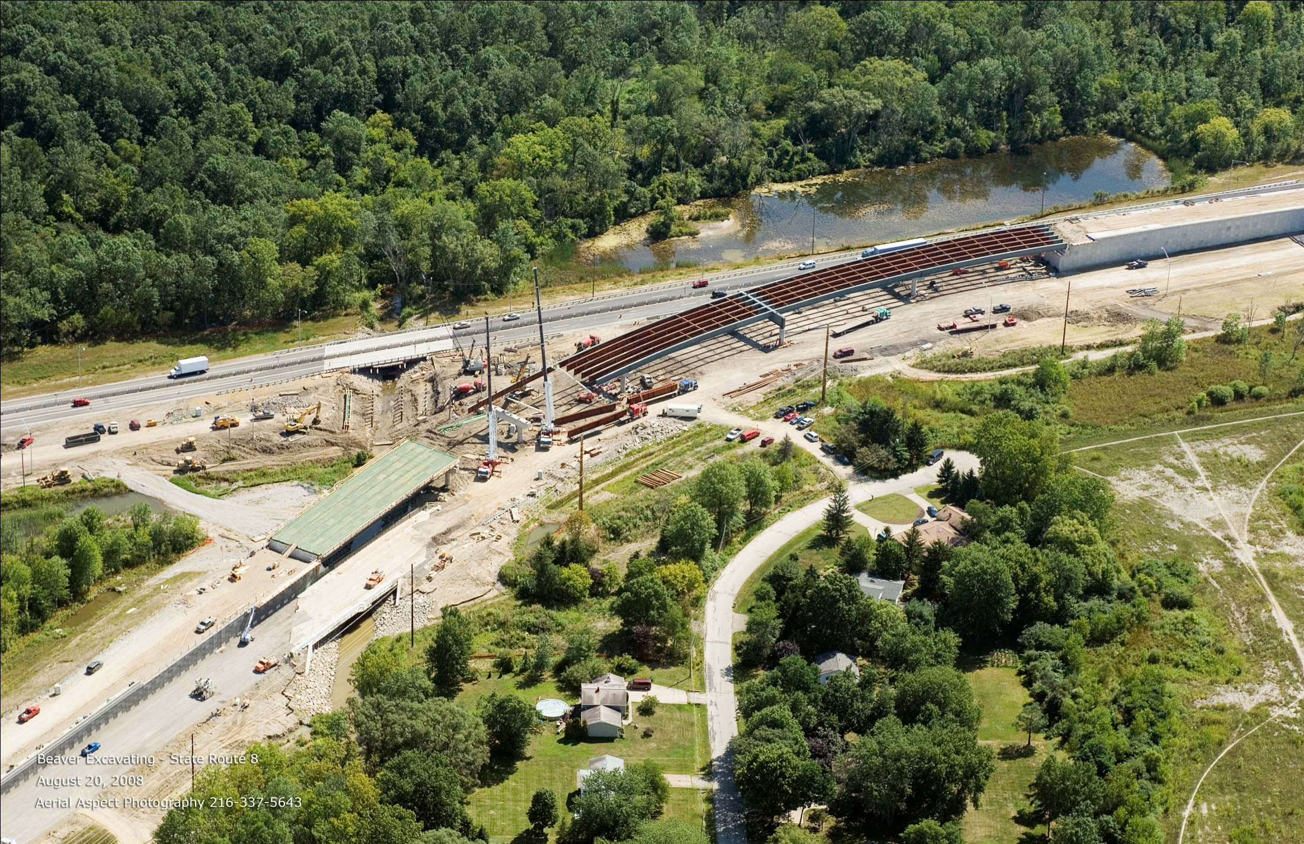

Slide 95
4/15/08

Slide 96
July 2006 October 2009

Slide 97
Questions

